Slide 1
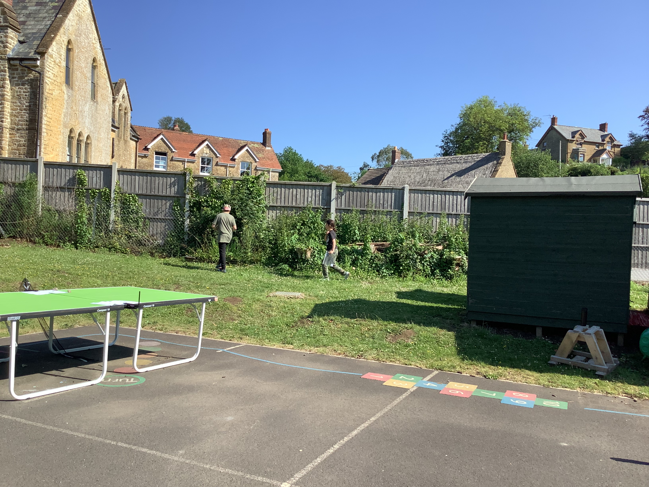
Orienteering
(School sports week intra school activity 23rd June 2021)
Seatown and Cogden began the day with an orienteering activity. Pupils in Seatown and Cogden were paired together. They learnt that orienteering maps have symbols that represent elements of the landscape. Each pair chose a word, matched it with the symbol to find and ran off to find it as quickly as possible before finding the next one. The aim was to find all 12 symbols somewhere in the school grounds faster than any other pair.

Slide 2
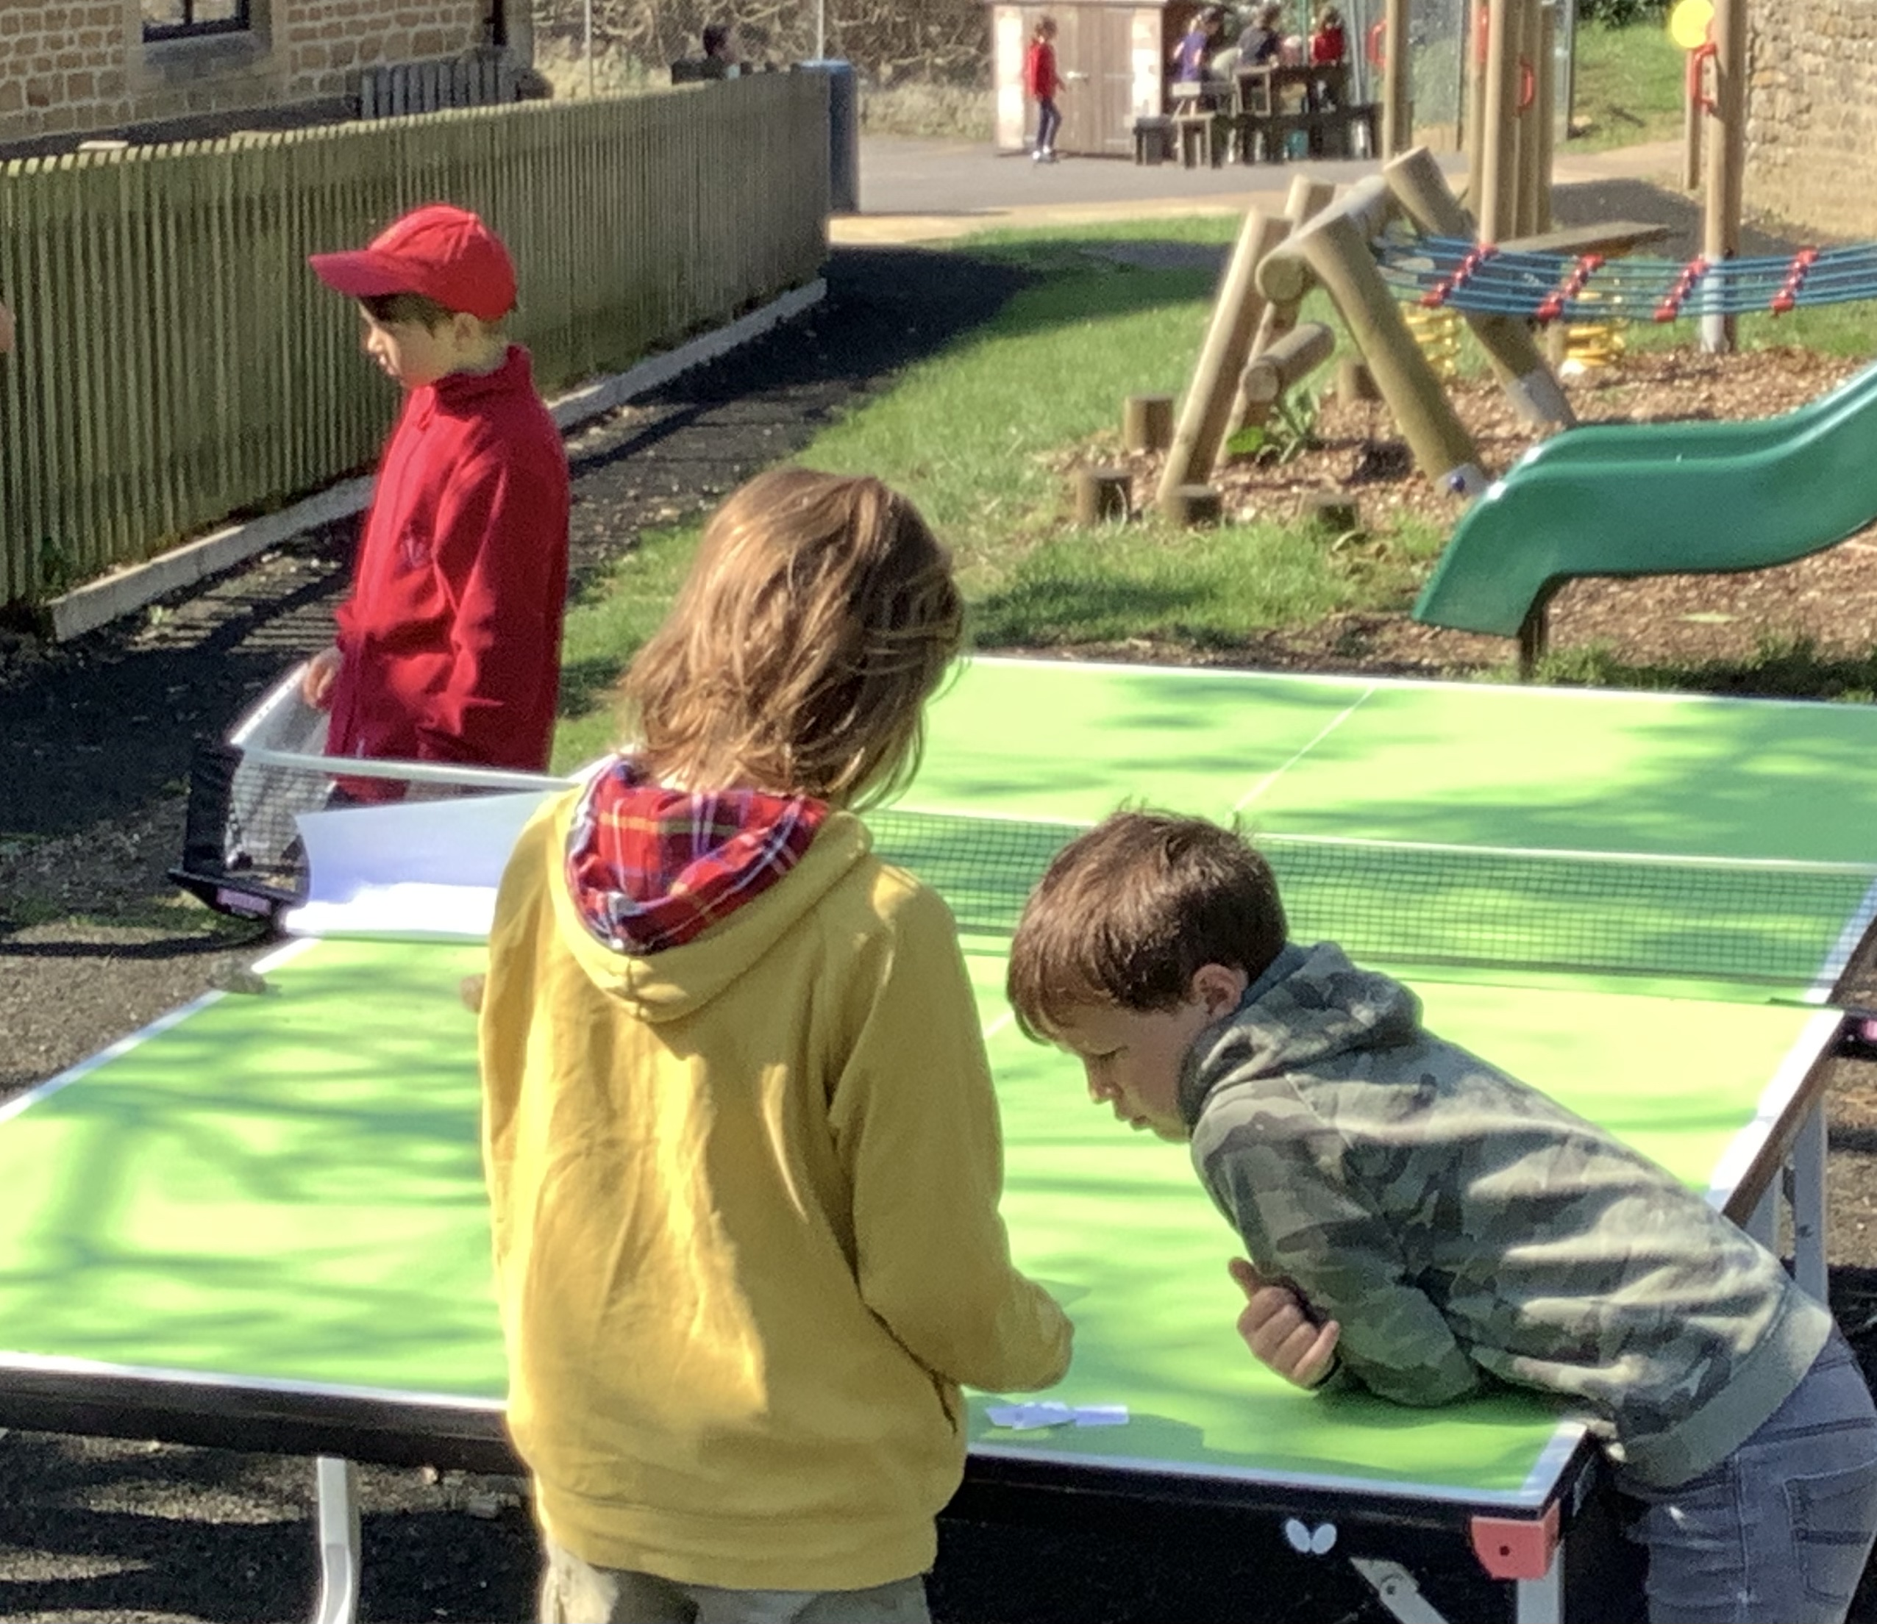
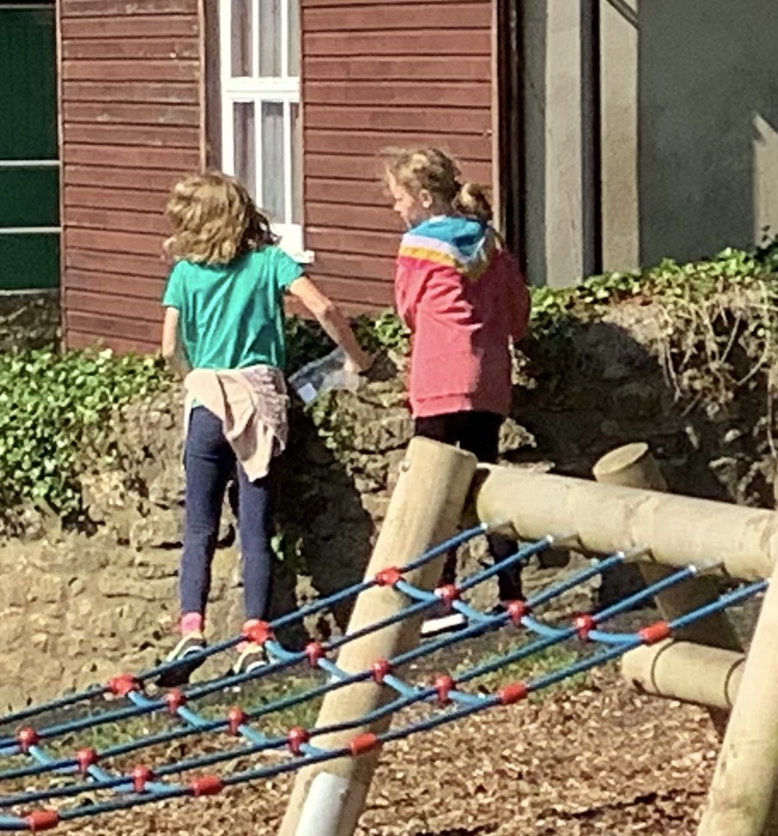
Tom and Monty matching a word with a letter.
“Where is it?” asked Kitty and Astrid.

Slide 3
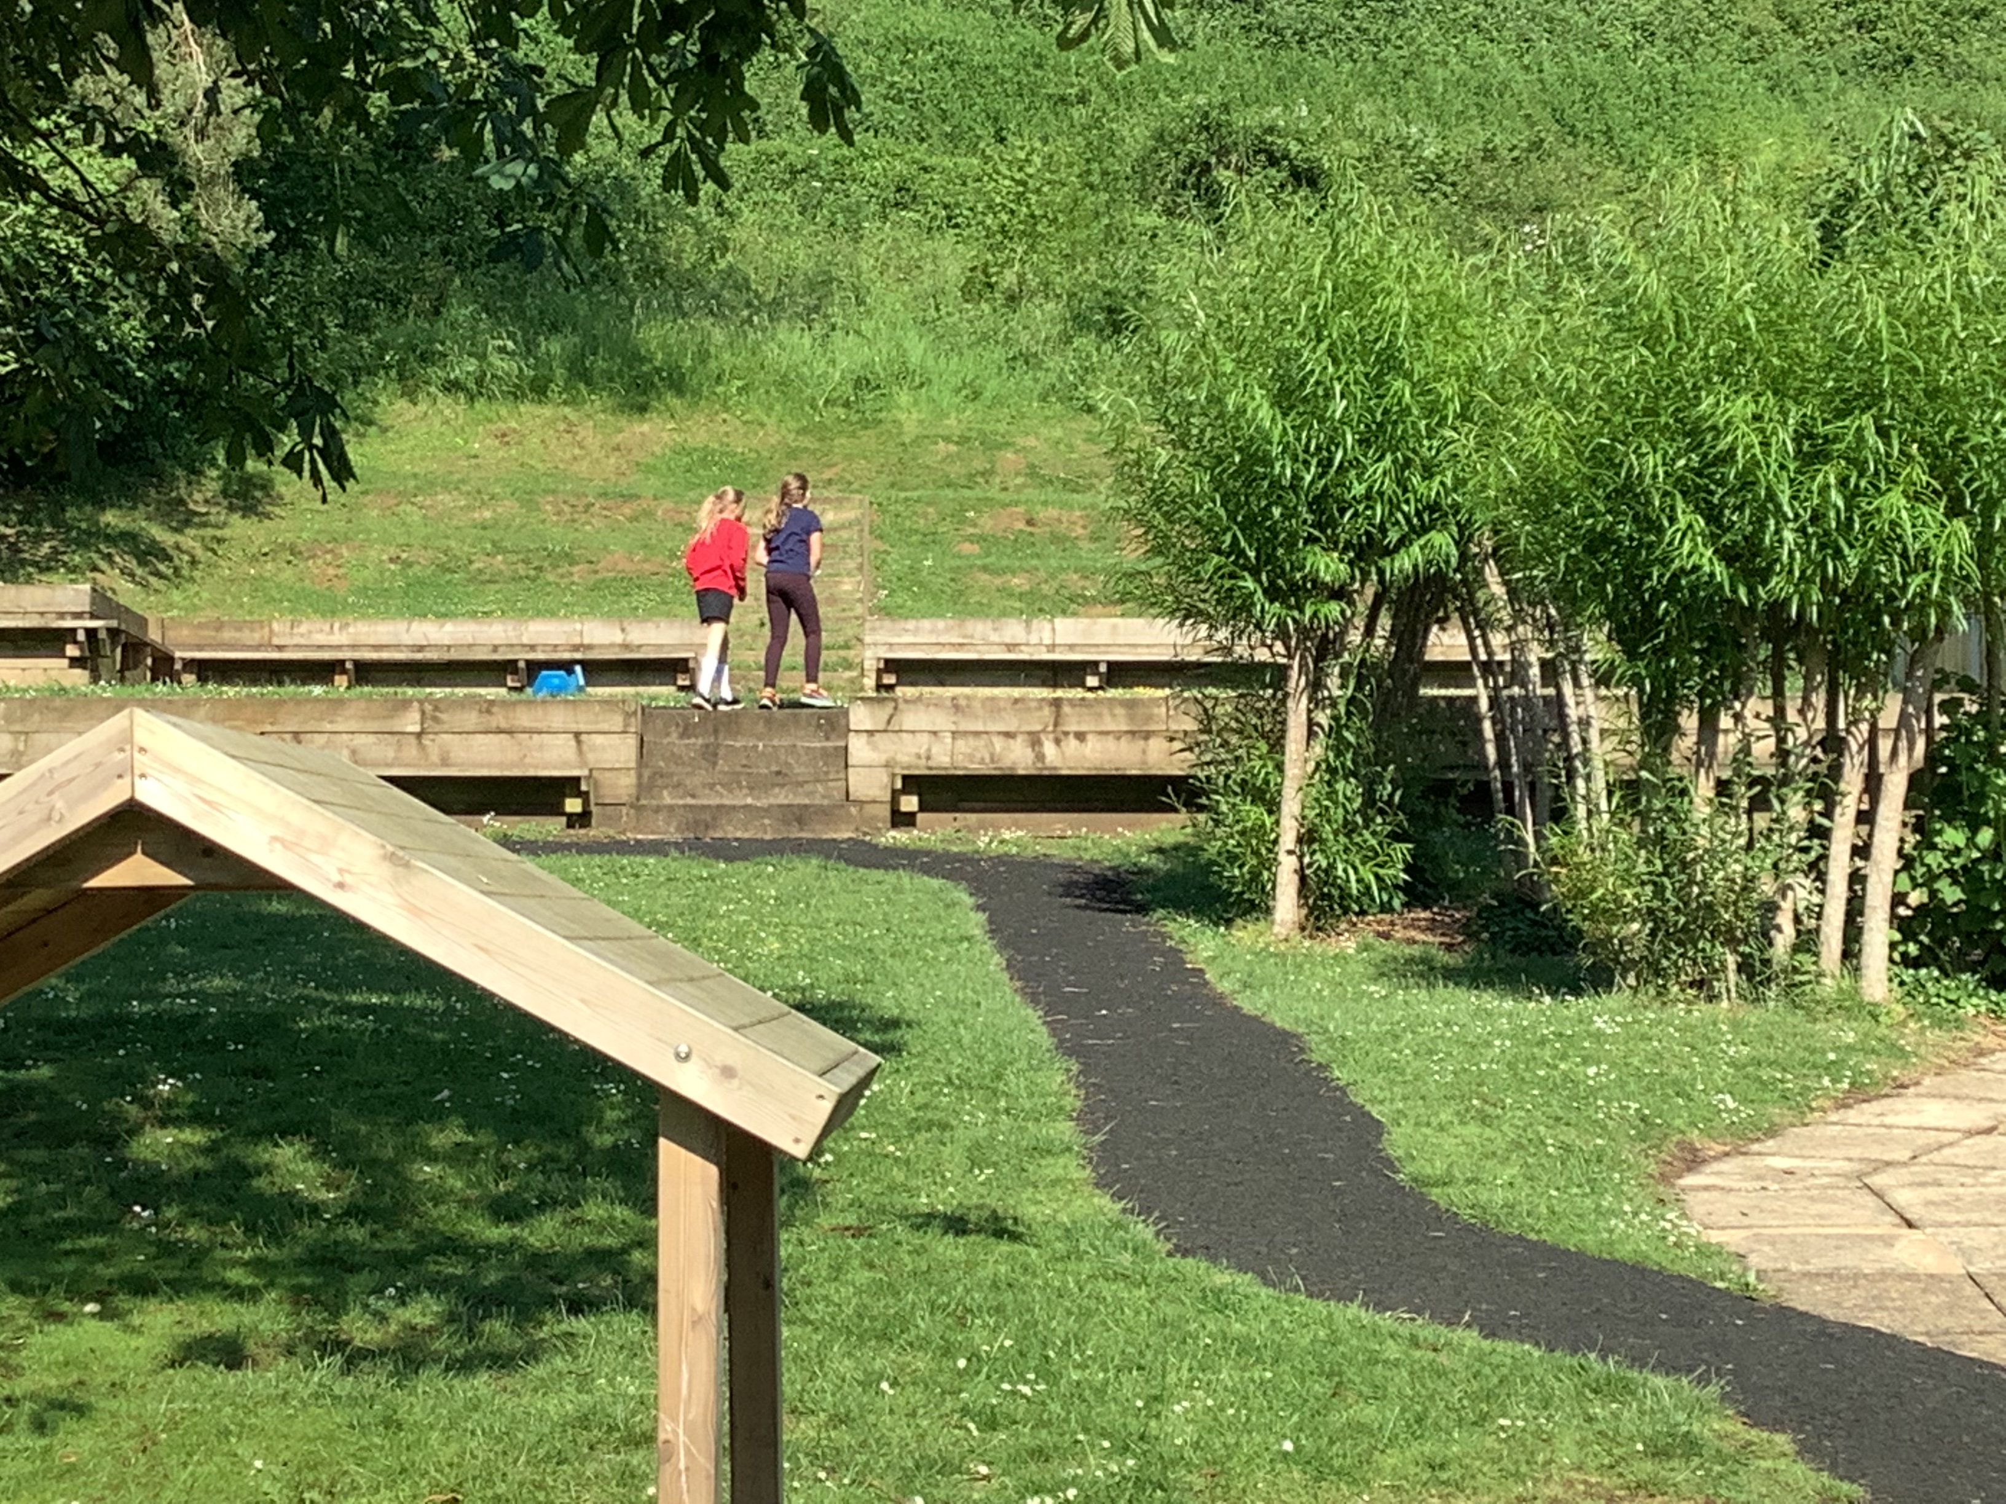
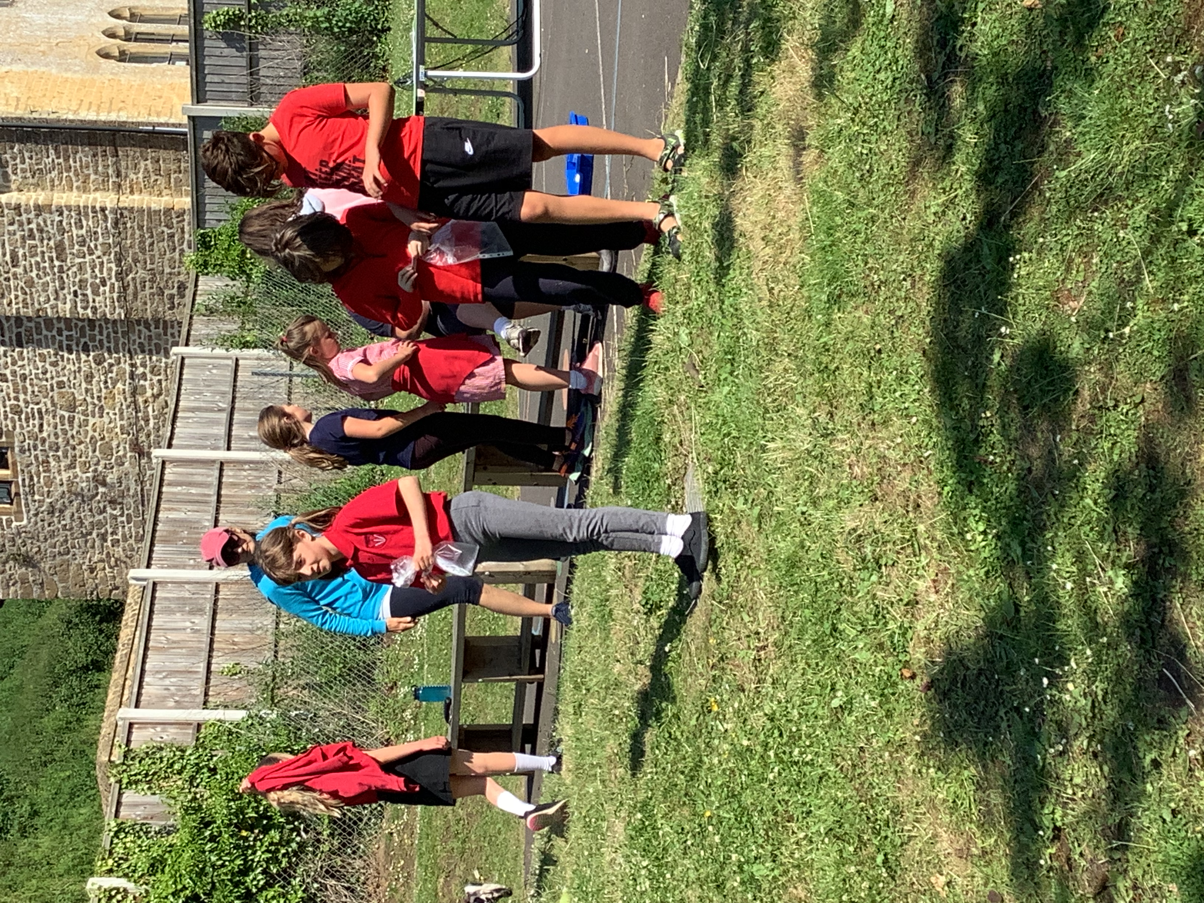
Even Mrs Mundy was wondering where to look next!
“It could be anywhere!” said Minka and Phoebe.

Slide 4
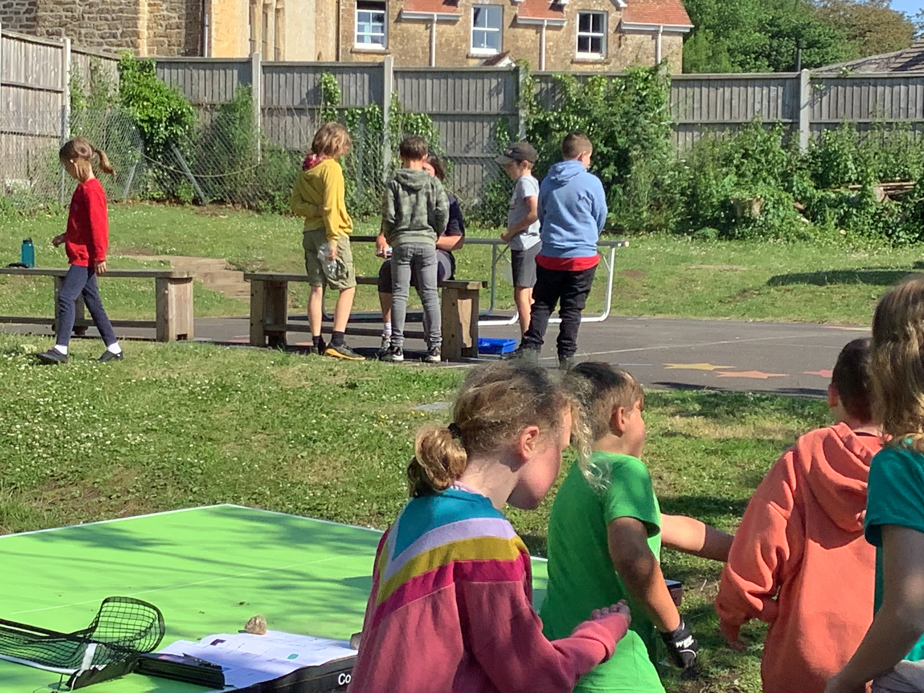
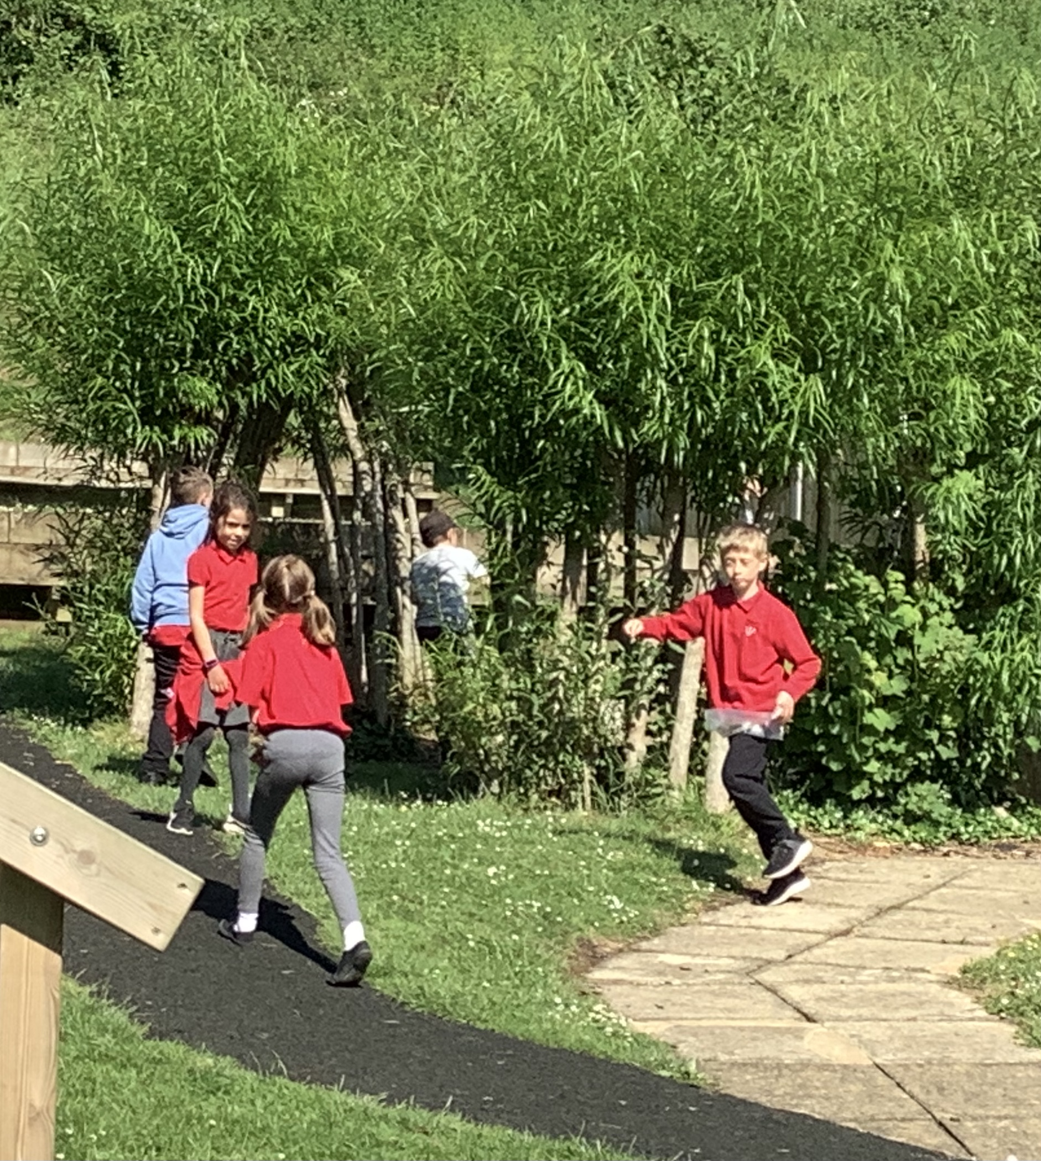
Mrs Cleden recorded which symbols each pair had found.
Ava-Mai and Niamh were racing against Elih and Harry.

Slide 5
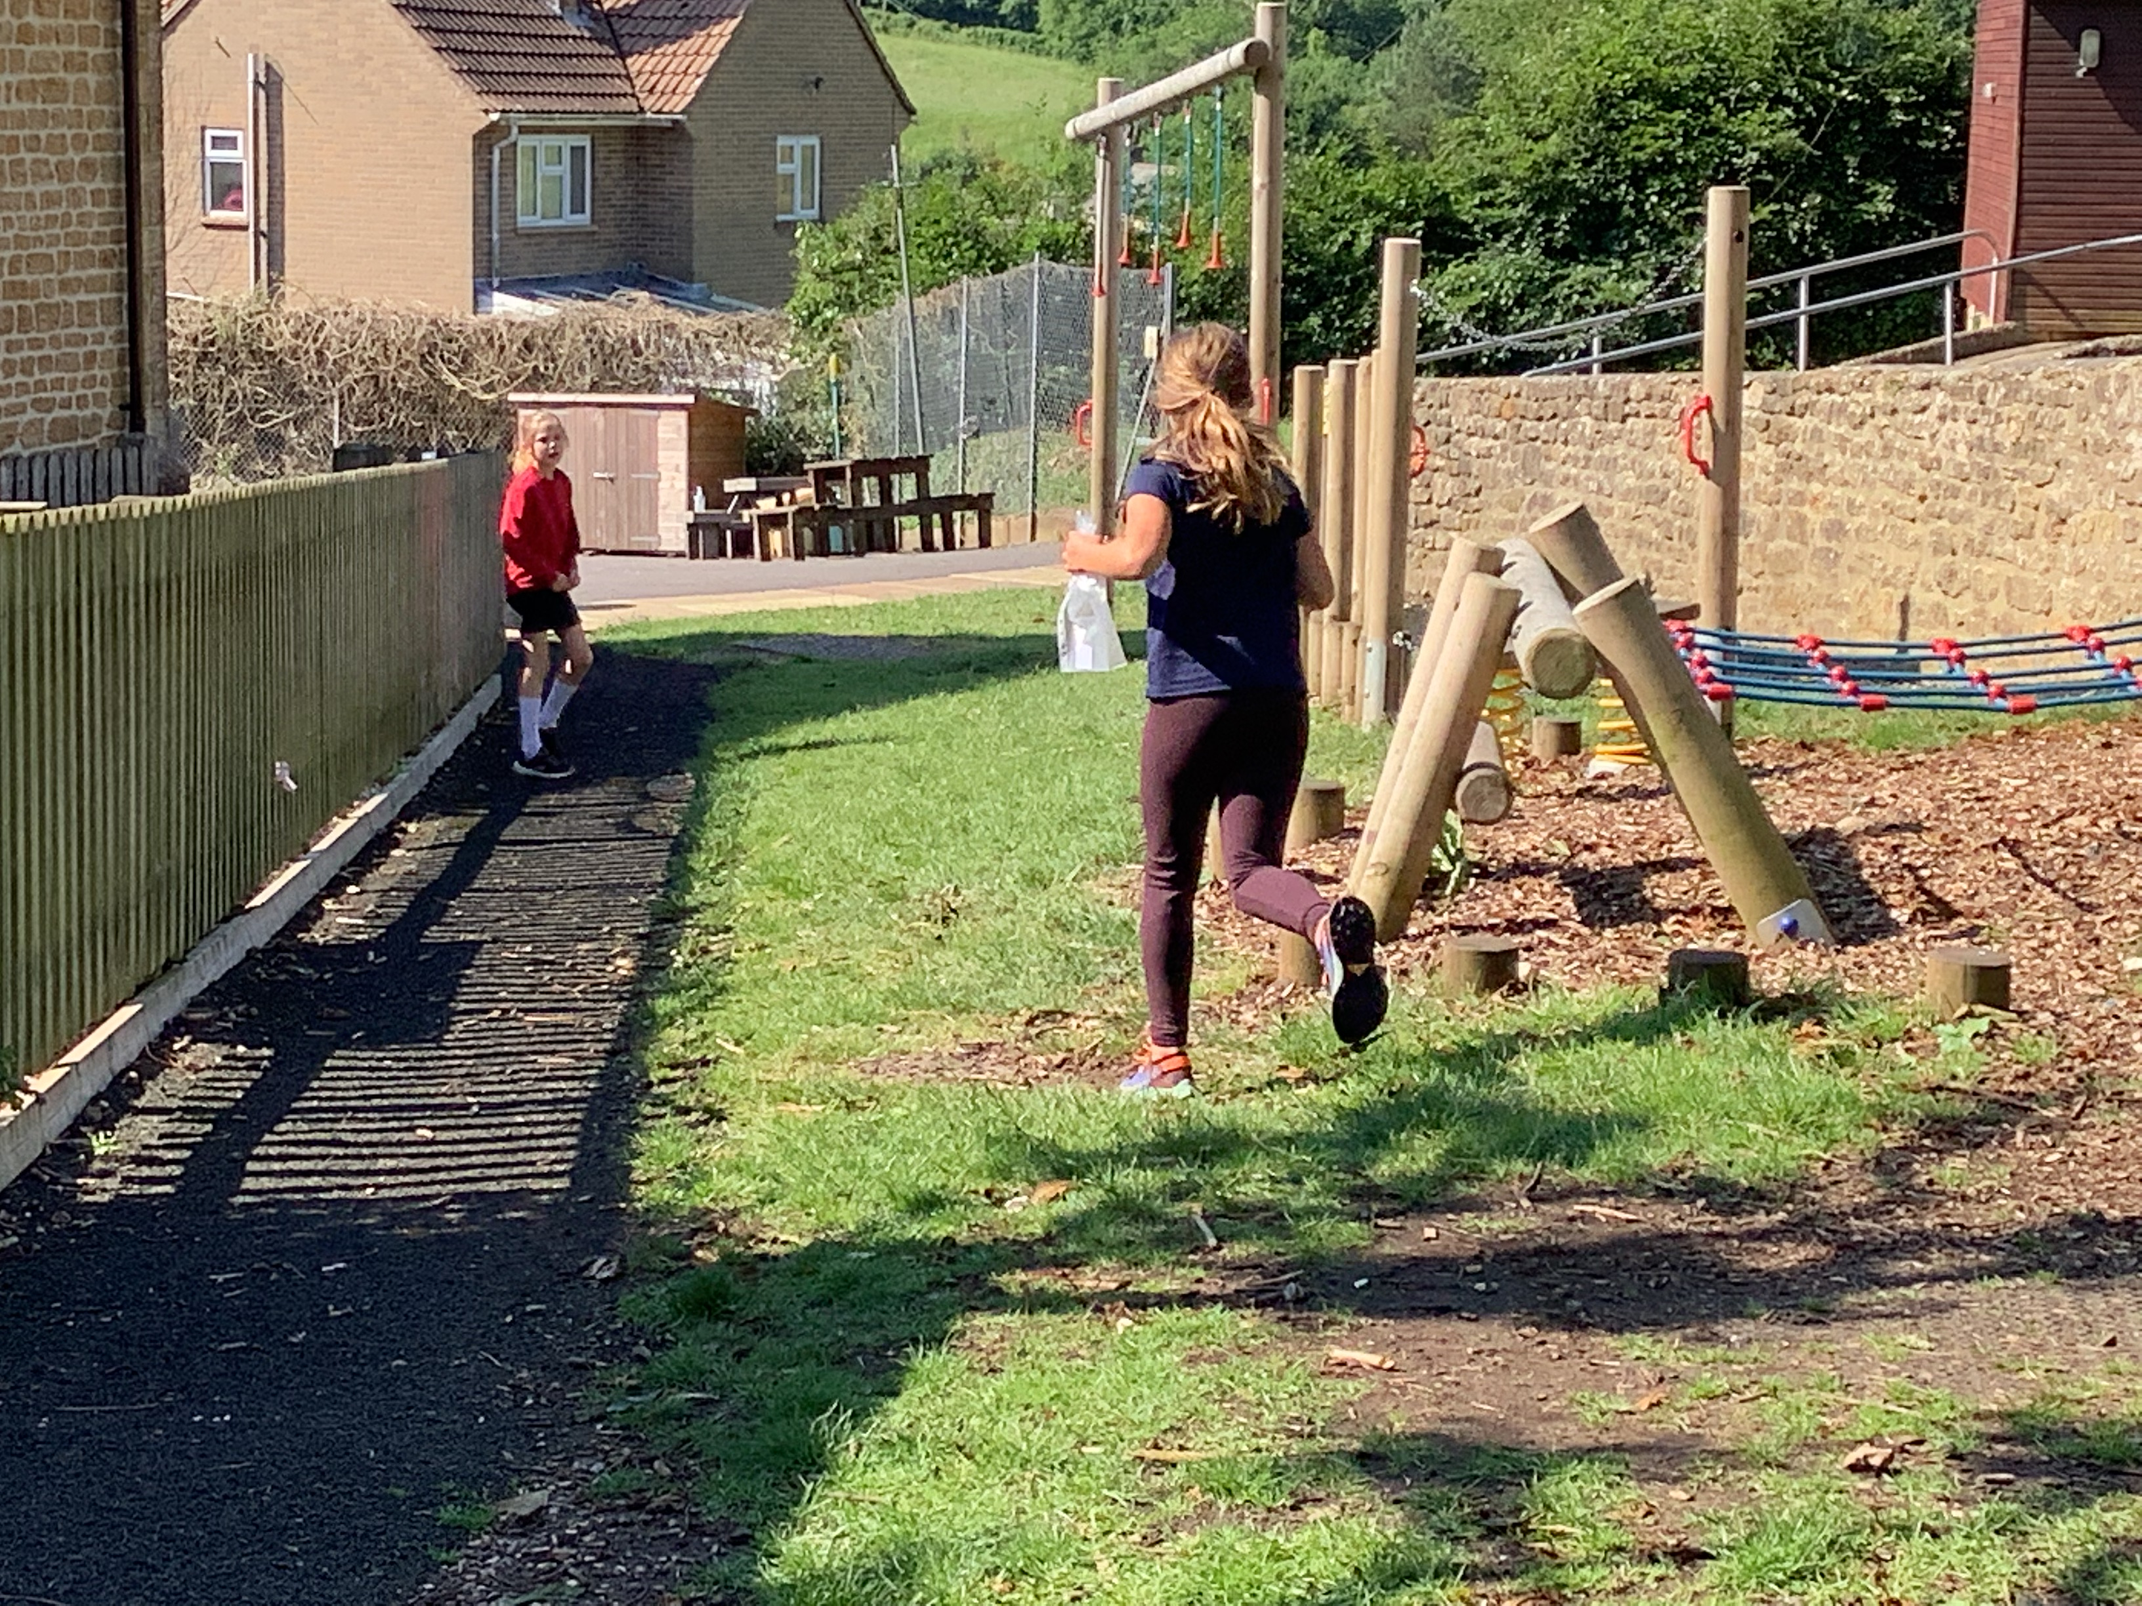
Meanwhile, Astrid and Kitty were STILL looking
for their symbol!
Minka and Phoebe raced on ahead.

Slide 6
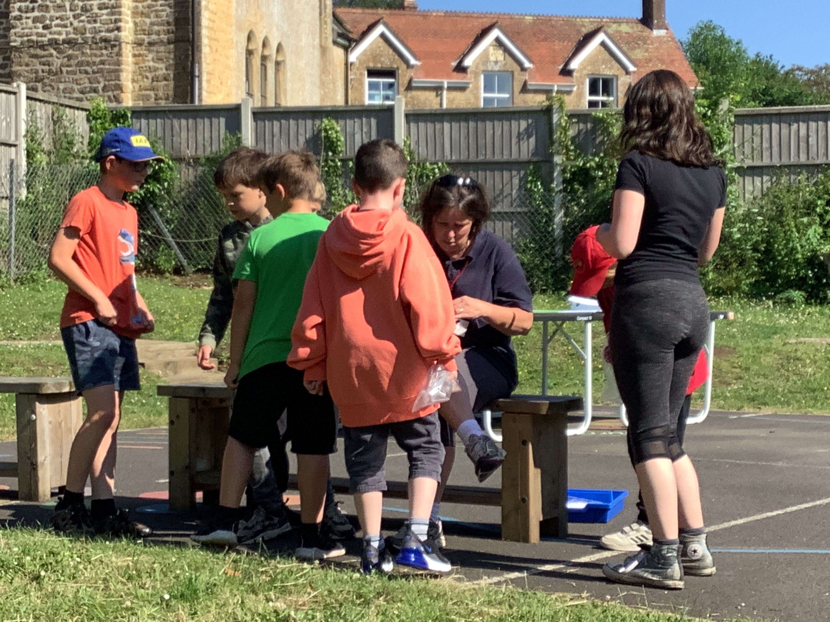
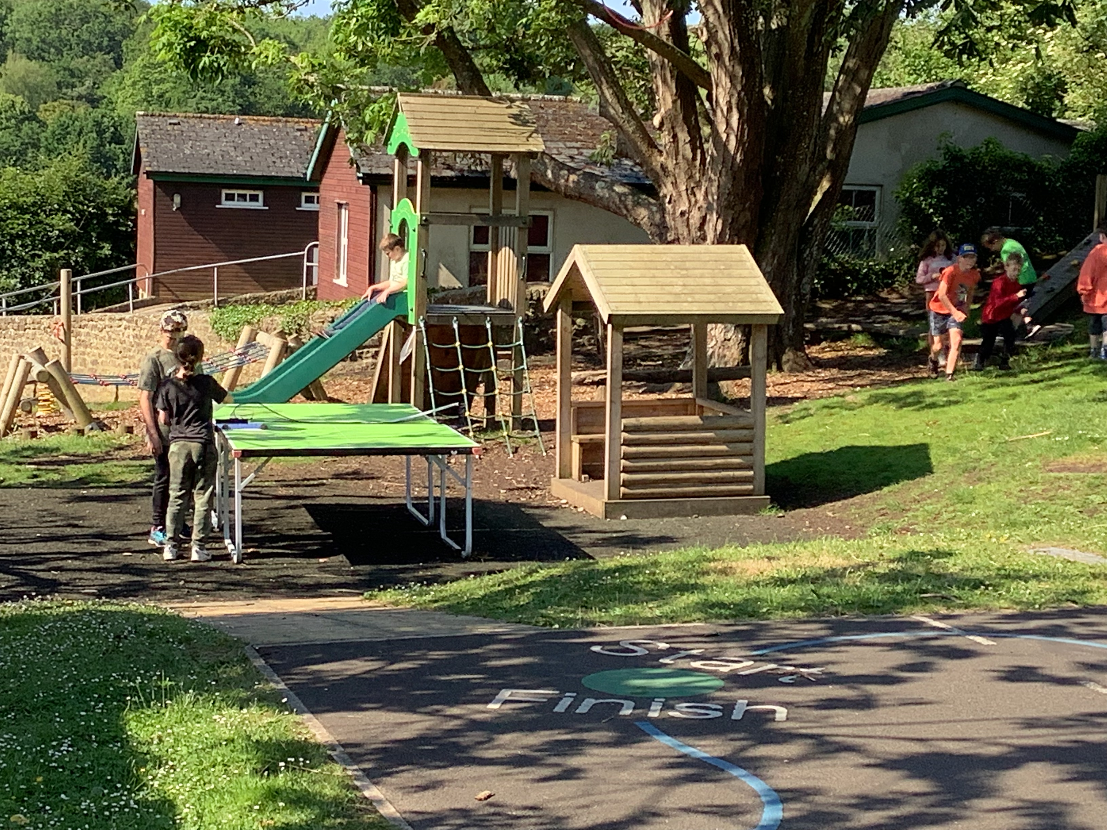
Results were coming in thick and fast!
Luca and Milo were matching a symbol to their next word…

Slide 7
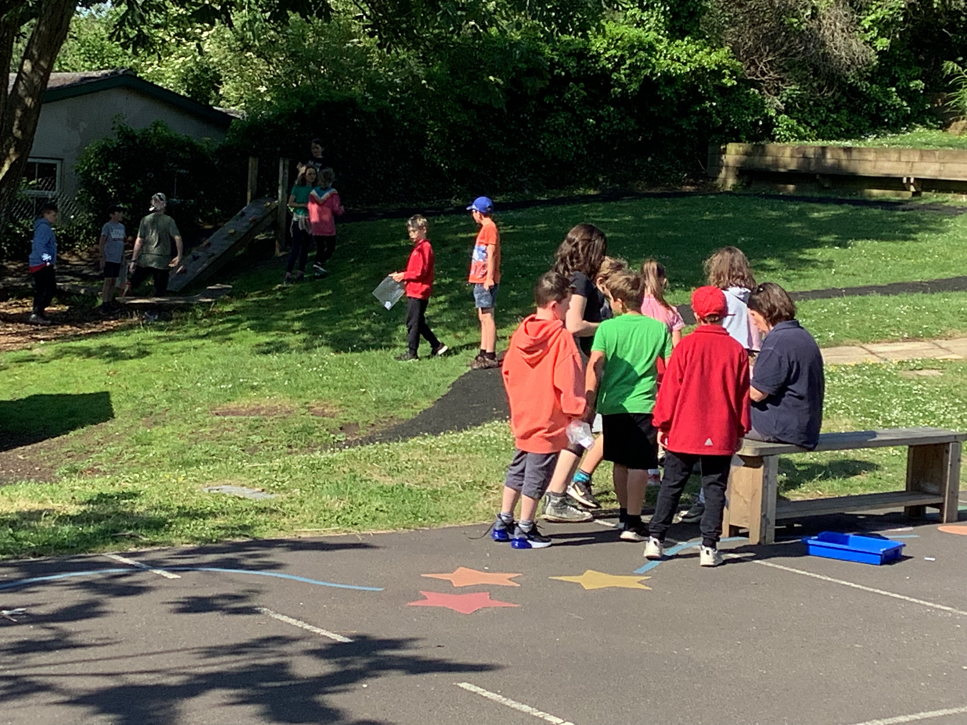
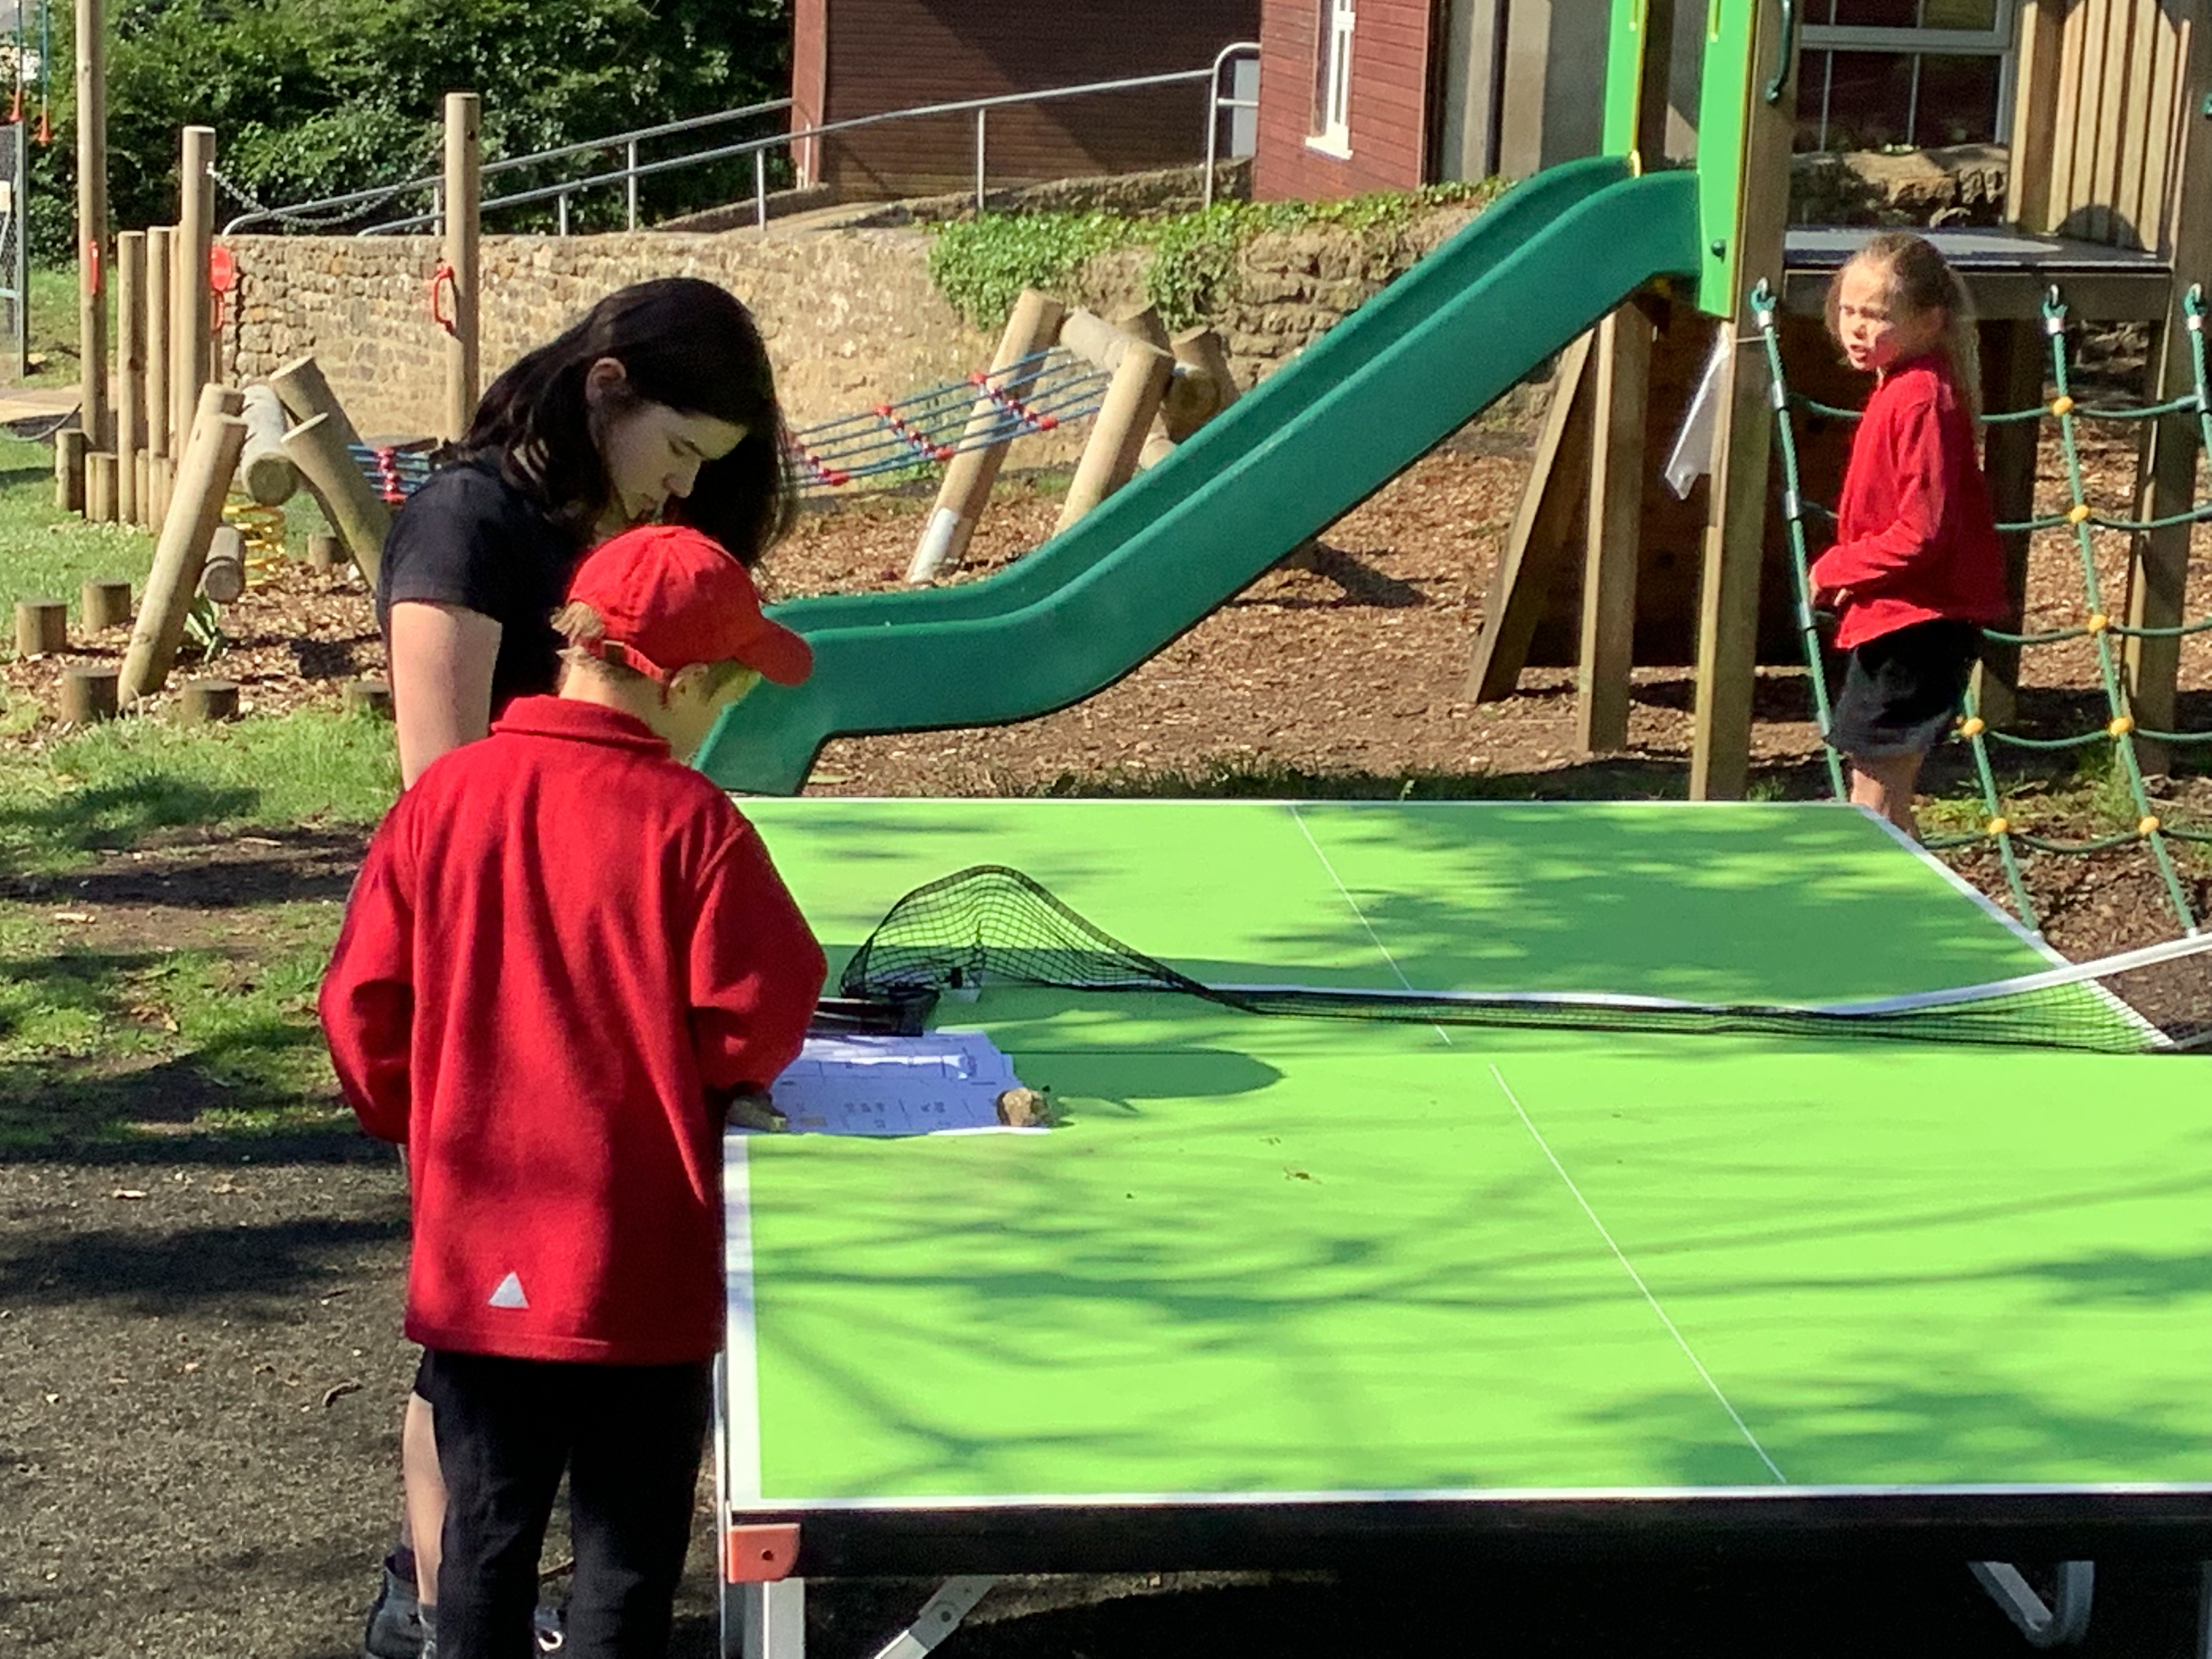
We have such lovely grounds to enjoy!
Amelia and Dylan in deep thought….

Slide 8
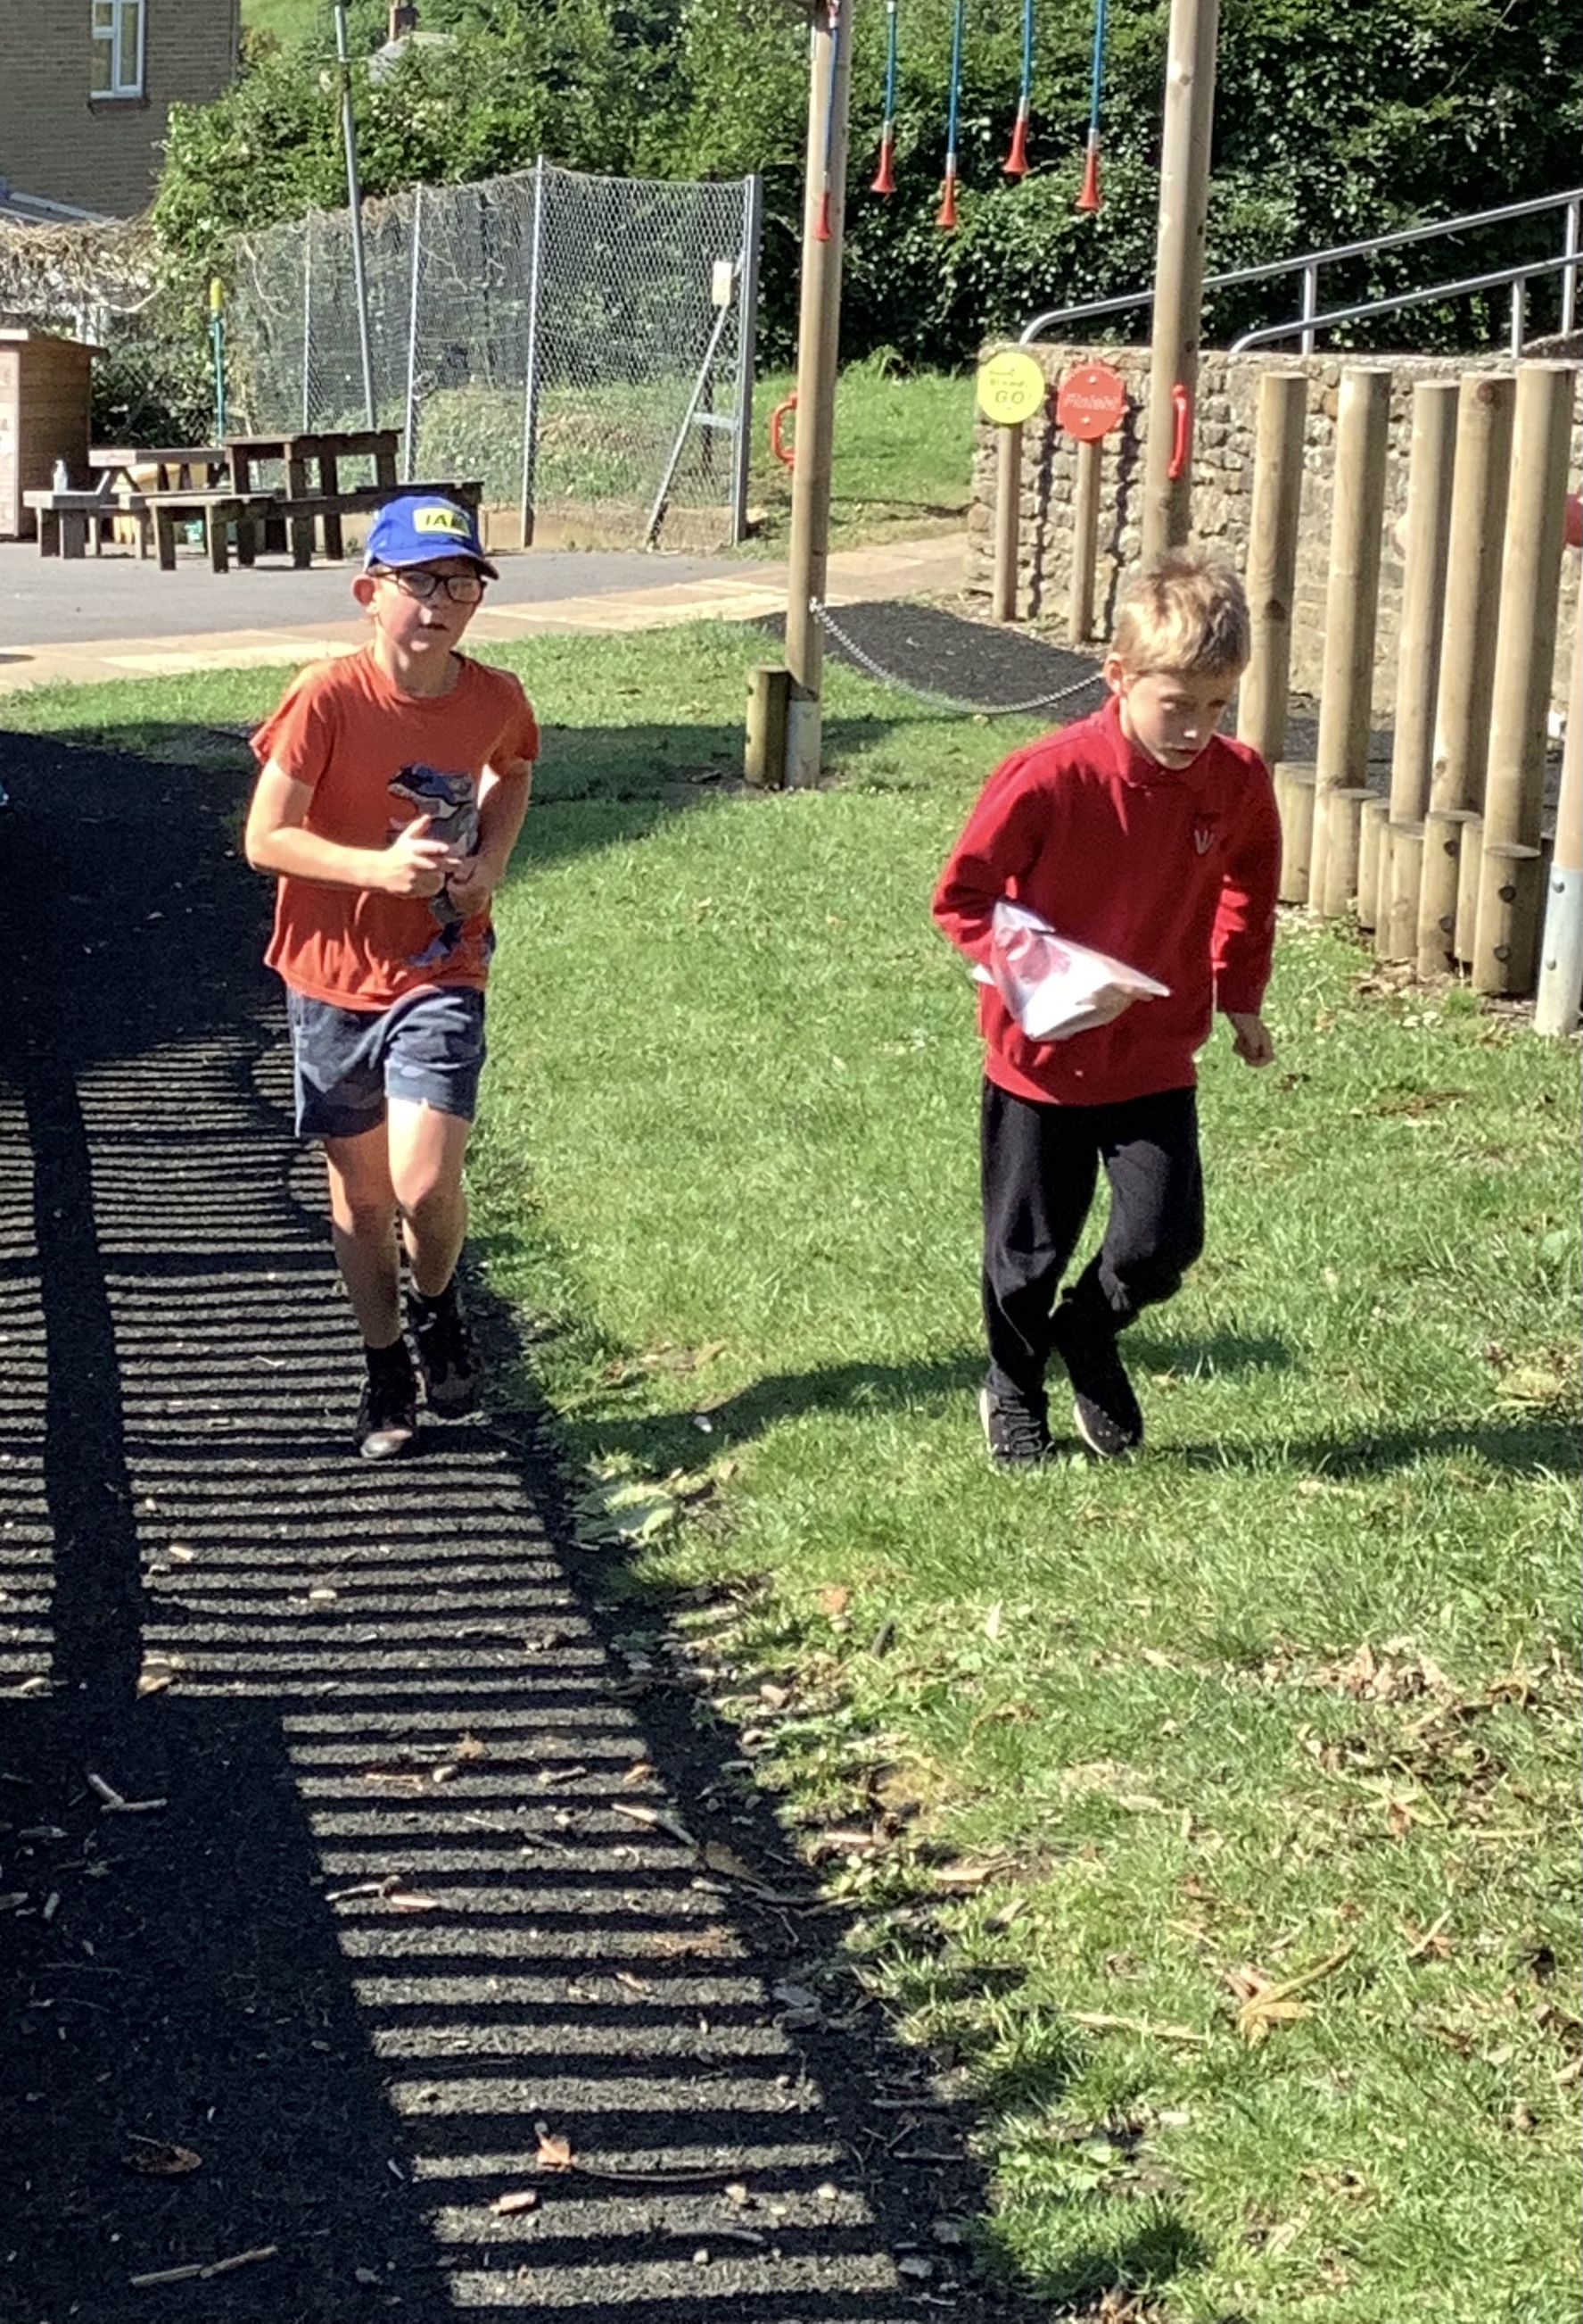
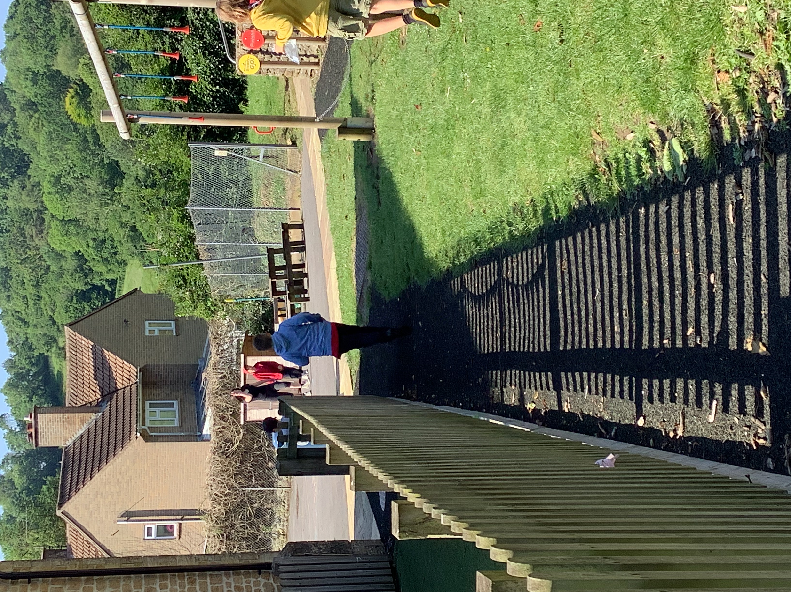
Anyone looking tired yet?

Slide 9
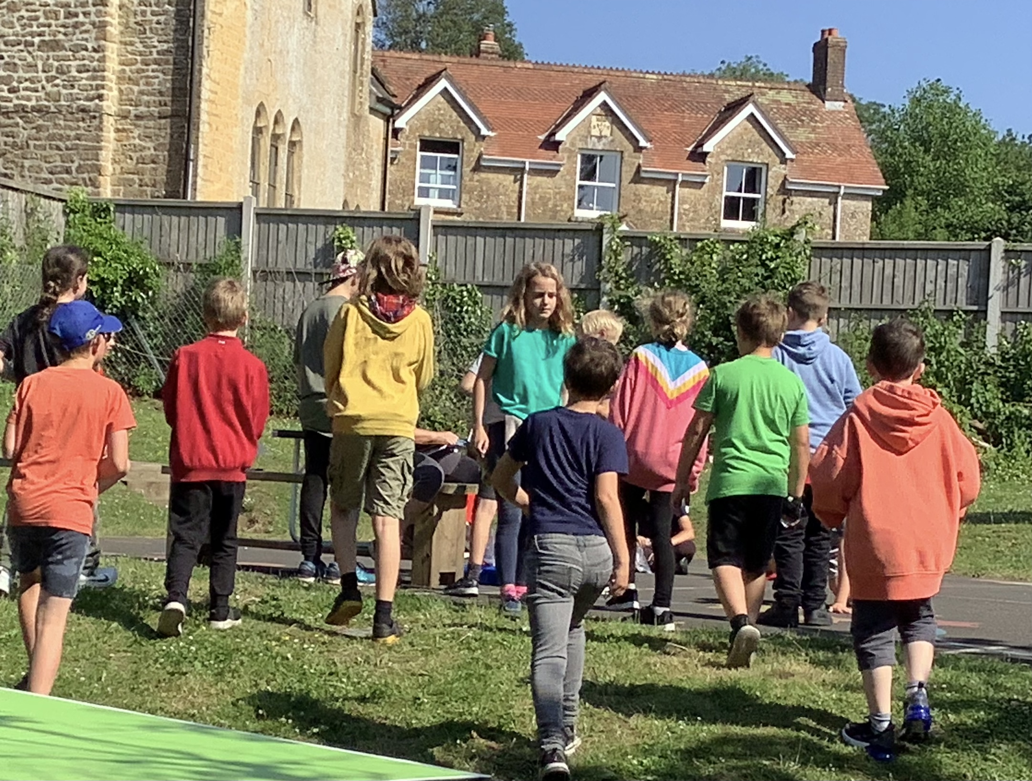
We all waited patiently for the results.
And the winners were:
3rd: Niamh/Ava-Mai
2nd: Lucas/Effra, Grace BB/Lexi, Tom/Monty, Astrid/Kitty
1st: Hugo/Harley, Finley/Marlowe, Minka/Phoebe
Well done, everyone!

Slide 10
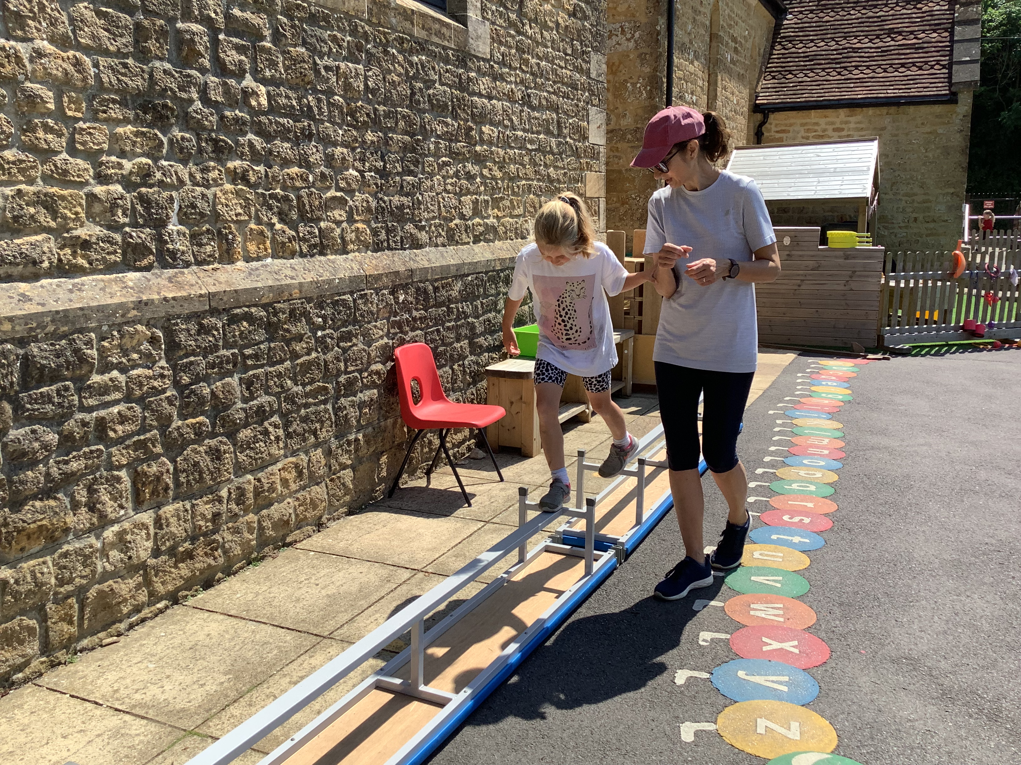
Multisports
This took place for the second half of the morning. All of KS2 swapped partners and completed a circuit of activities, trying to gain as many points to become the multisports champions.

Slide 11
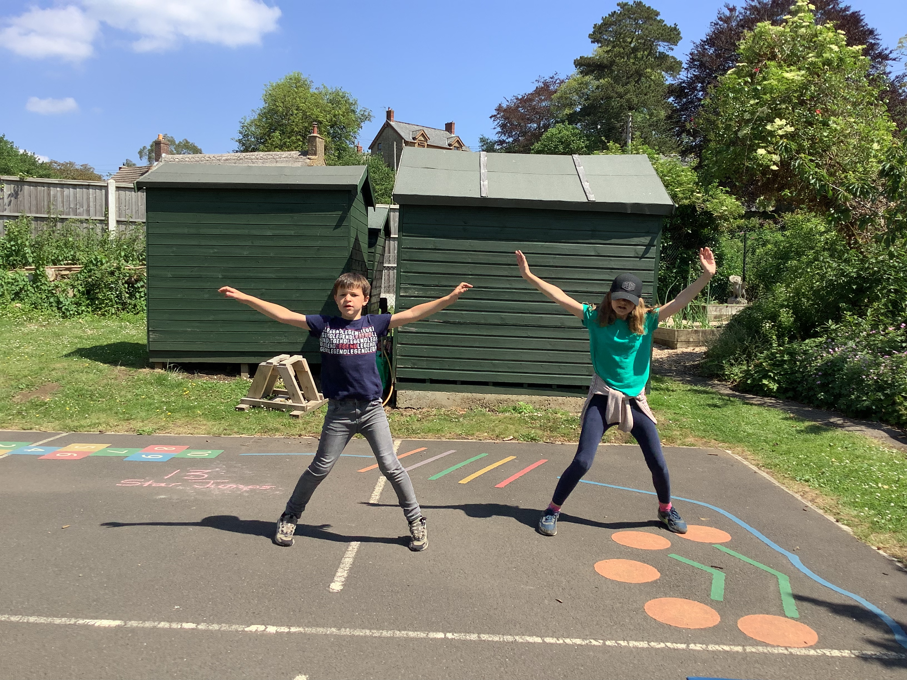
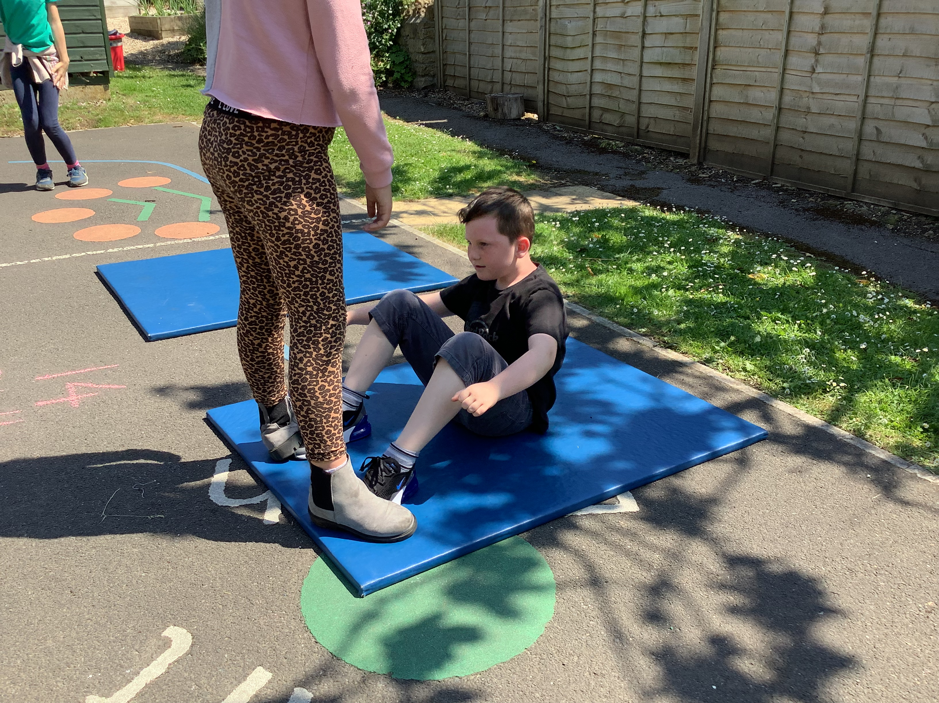
Star jumps were pretty exhausting but Monty and Kitty were showing us how it was done.
Hugo was working so hard on his sit ups!
Don’t stand on his feet too heavily, Grace!!

Slide 12
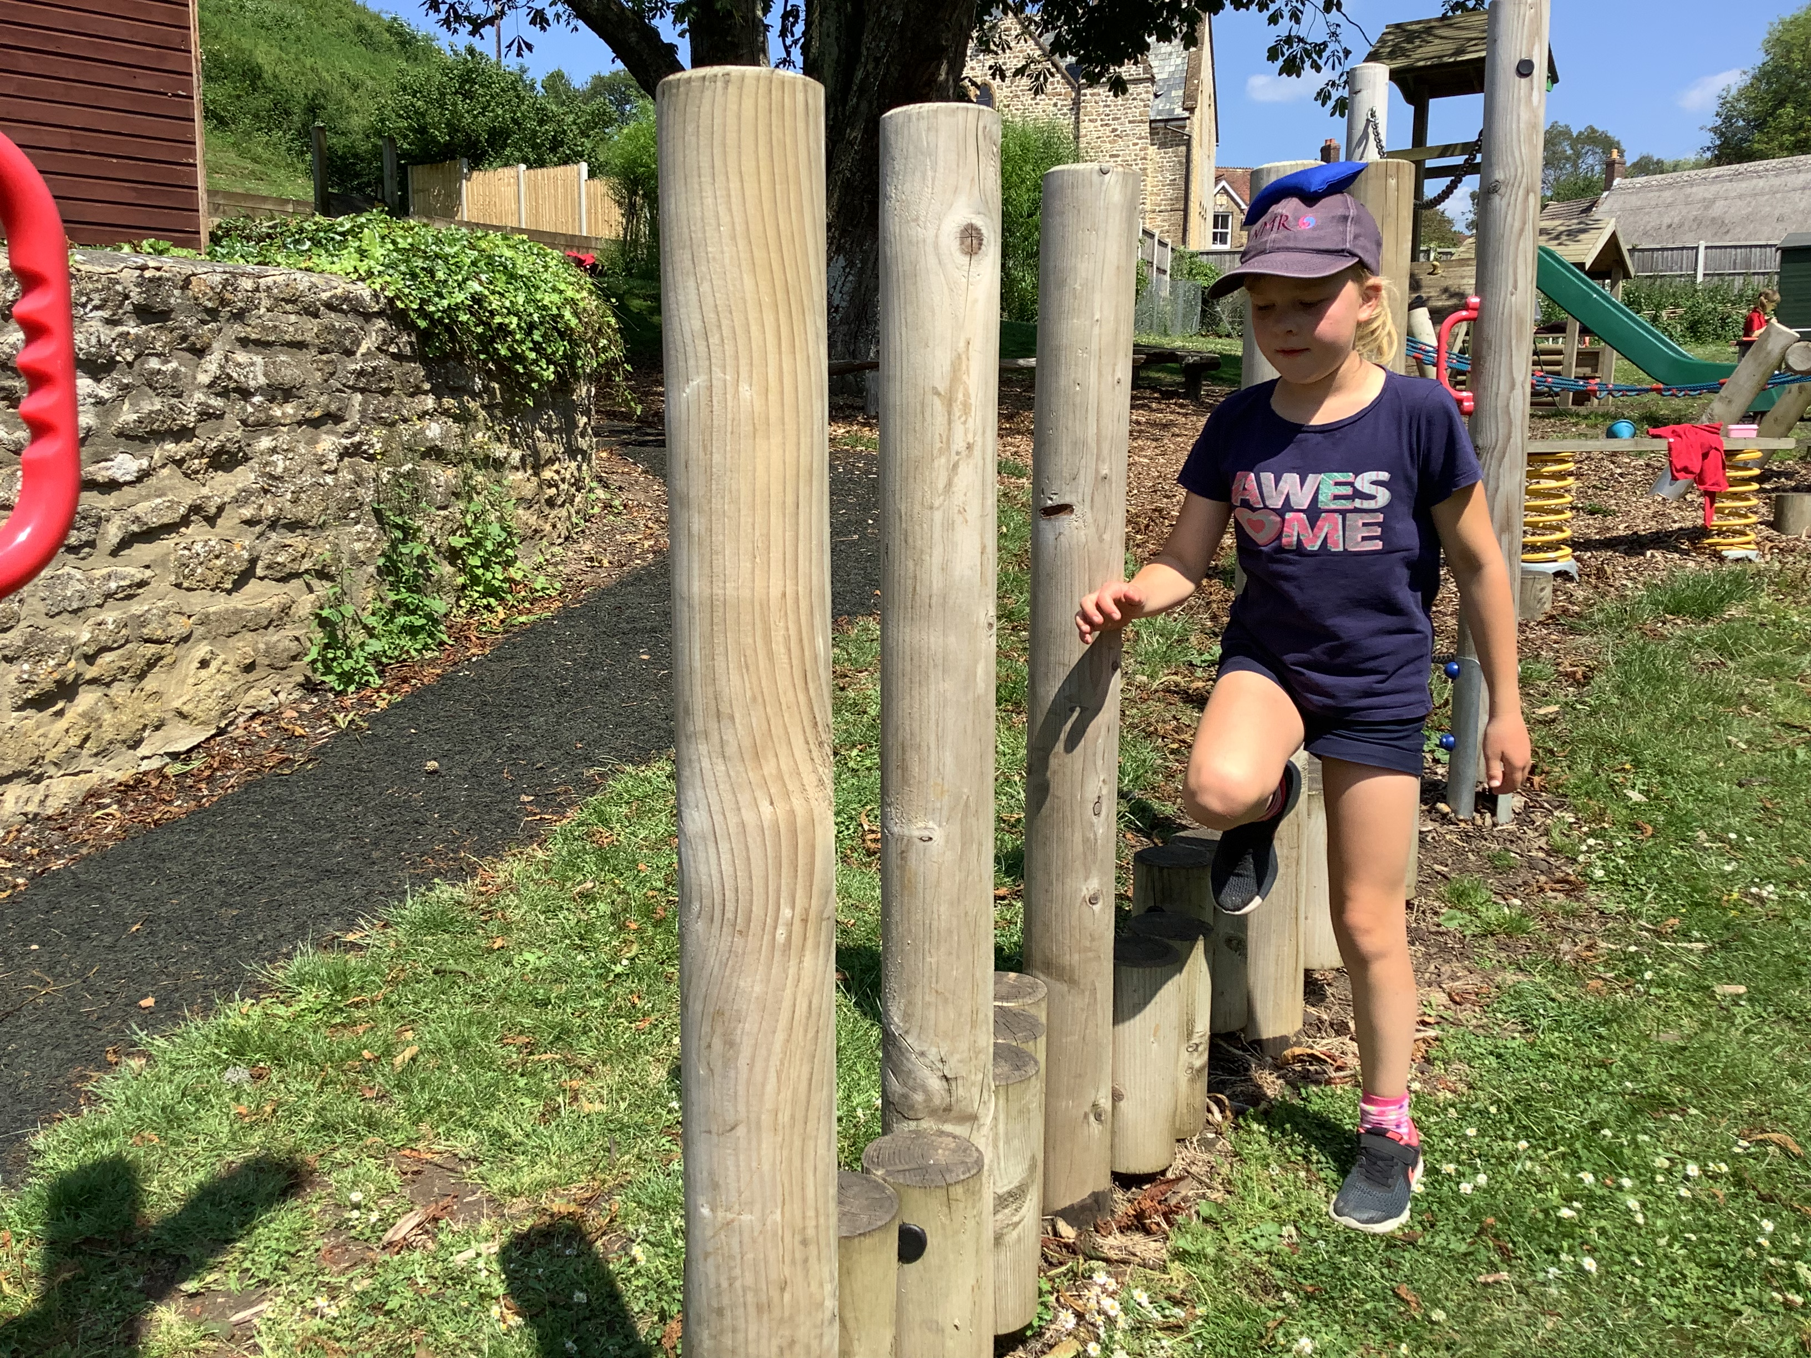
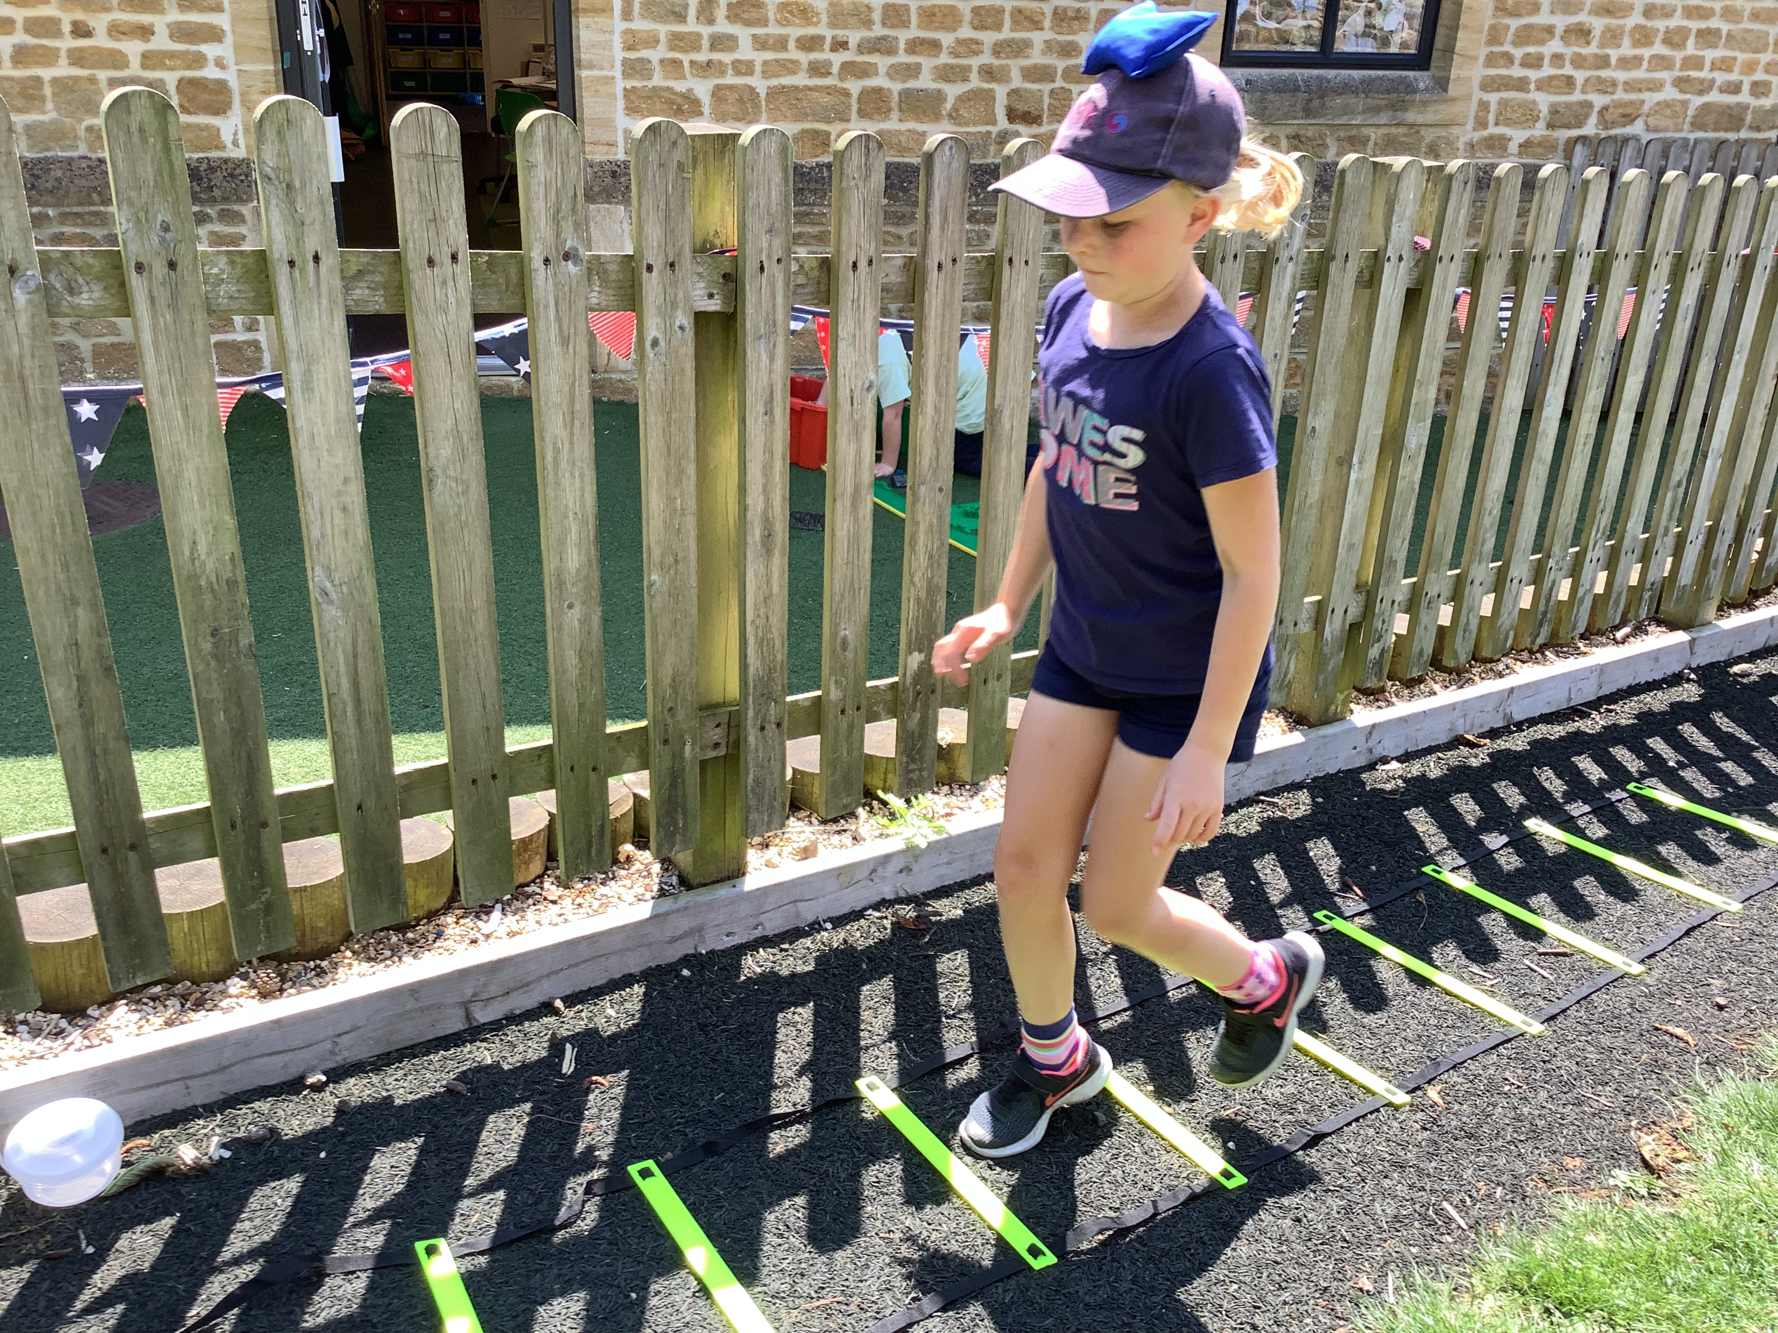
It’s all about balance……
…..and foot work.

Slide 13
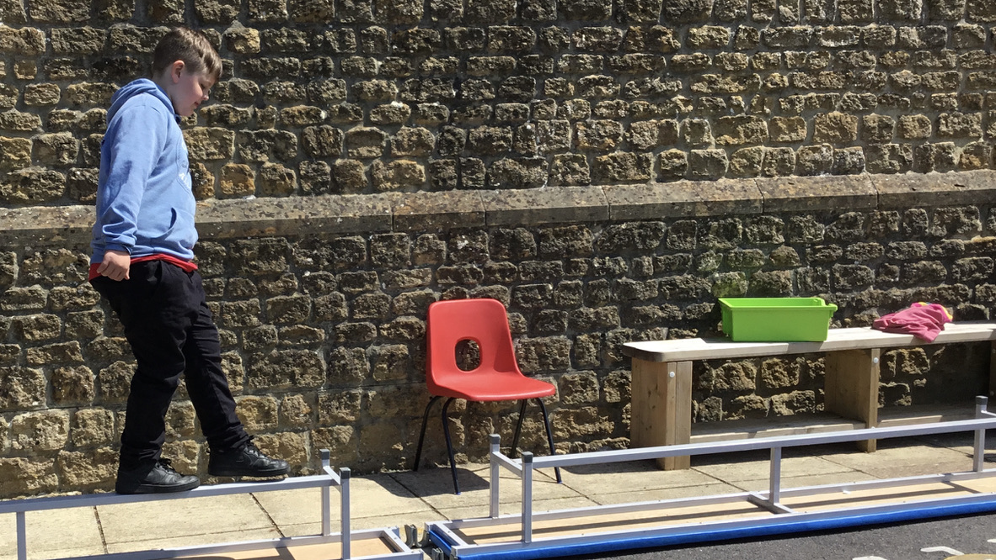
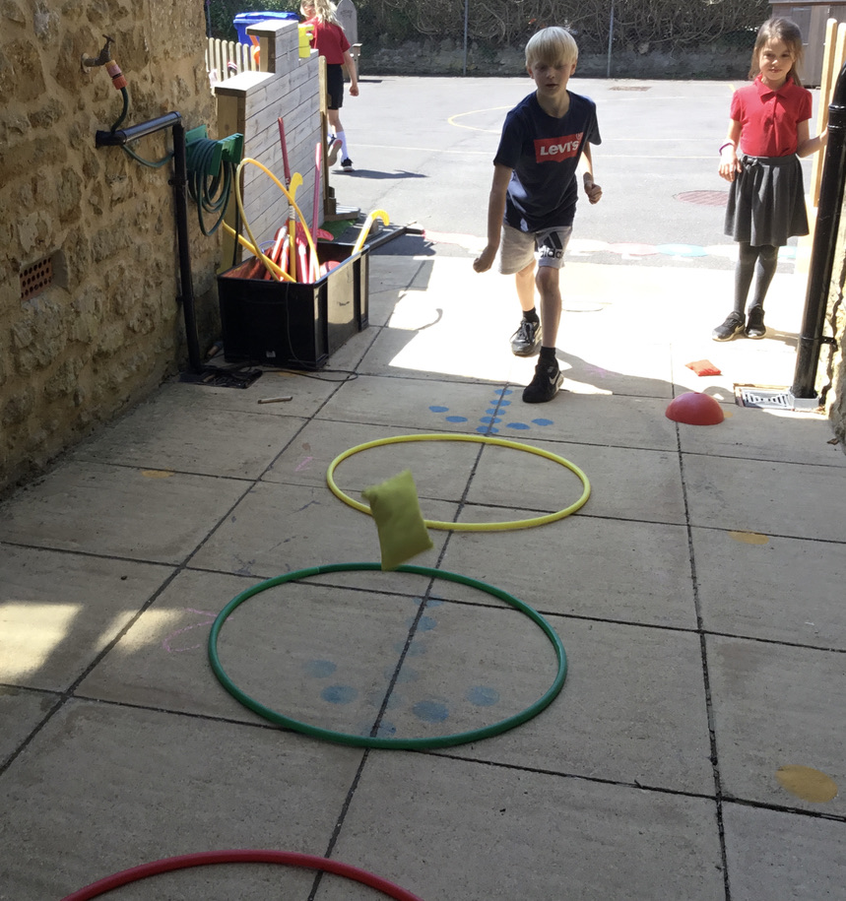
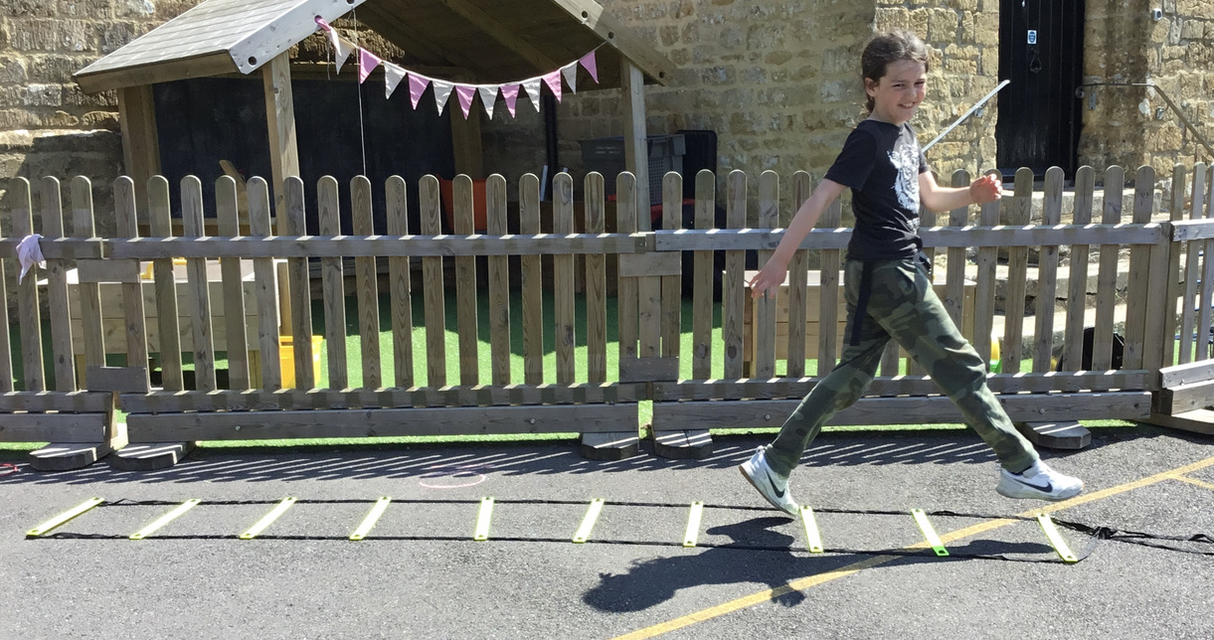

Slide 14
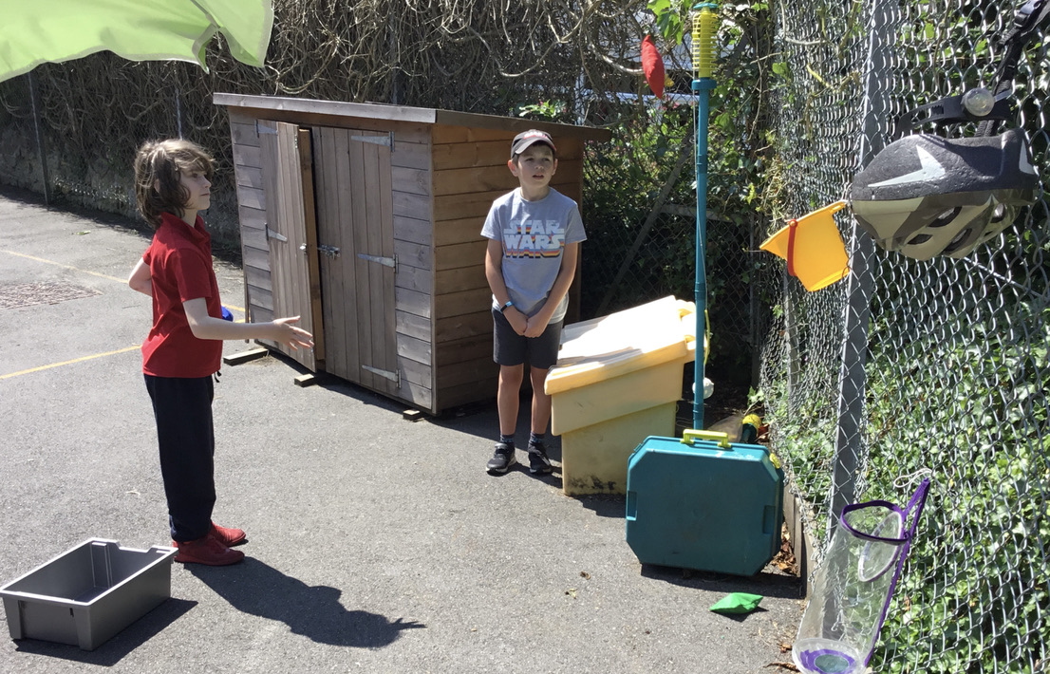
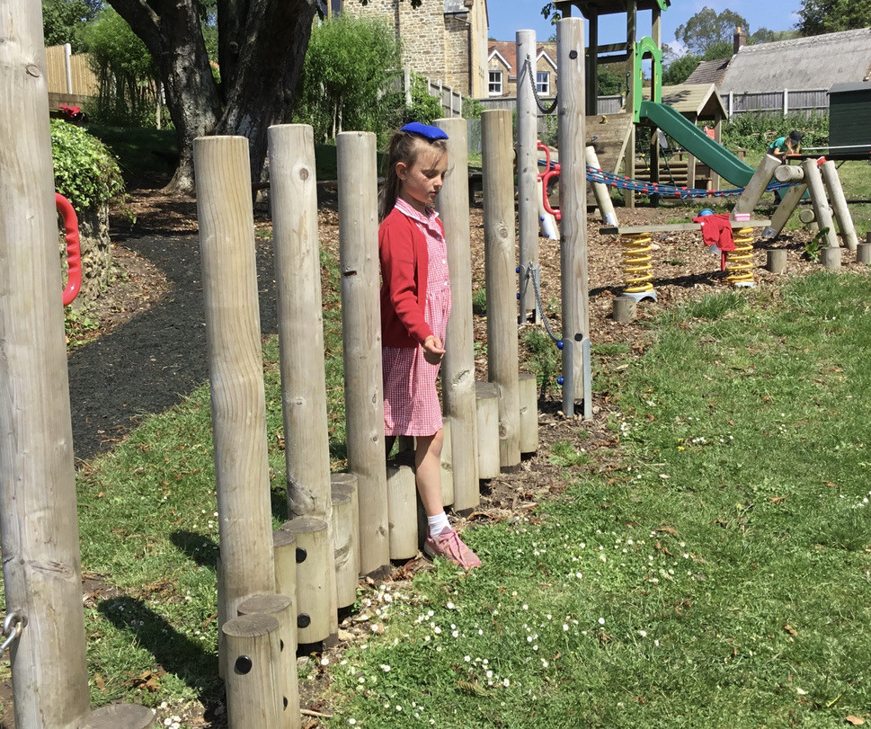
Throwing into a target, balancing bean bags on heads……

Slide 15
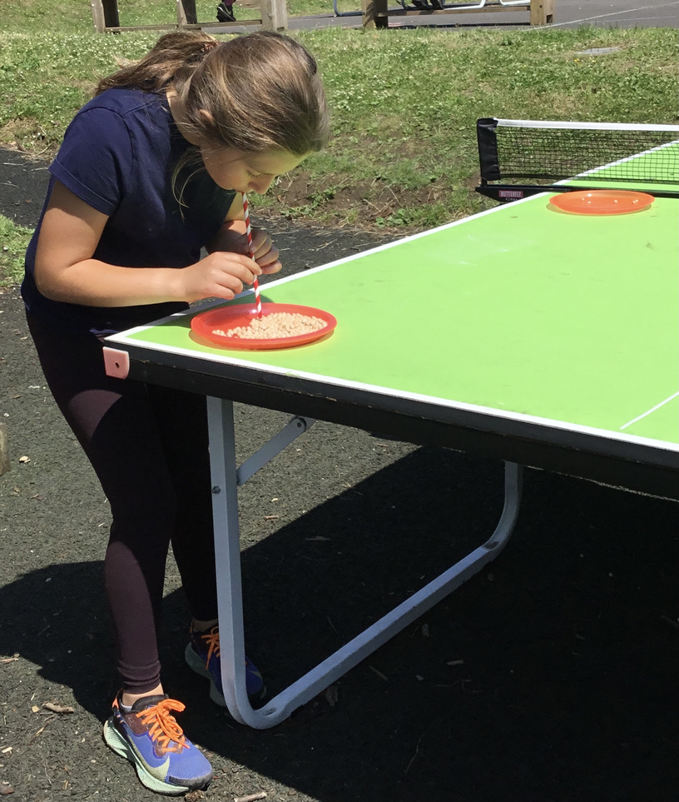
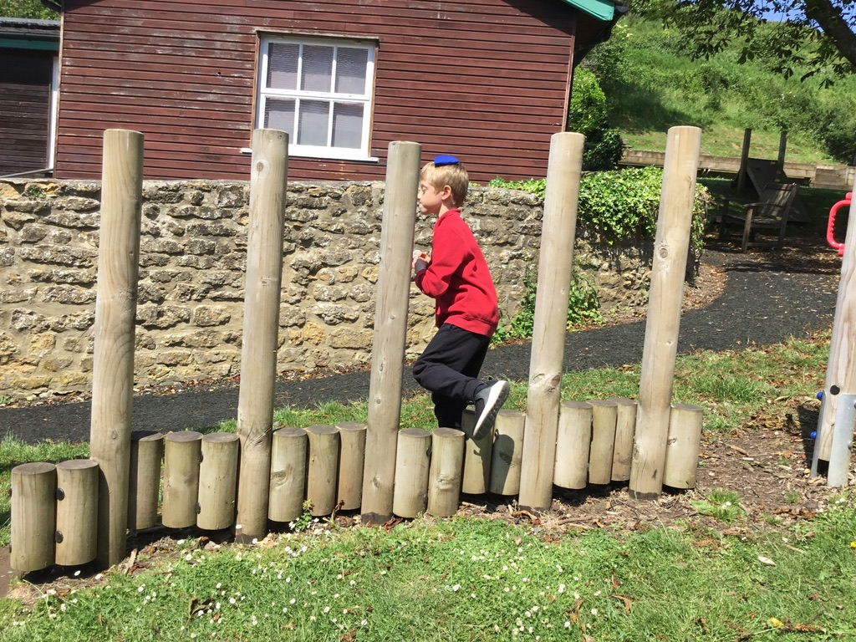
Elih’s doing well. Minka’s transferring dried peas from one plate to another……. well, we do need good lung capacity when we’re being active!

Slide 16
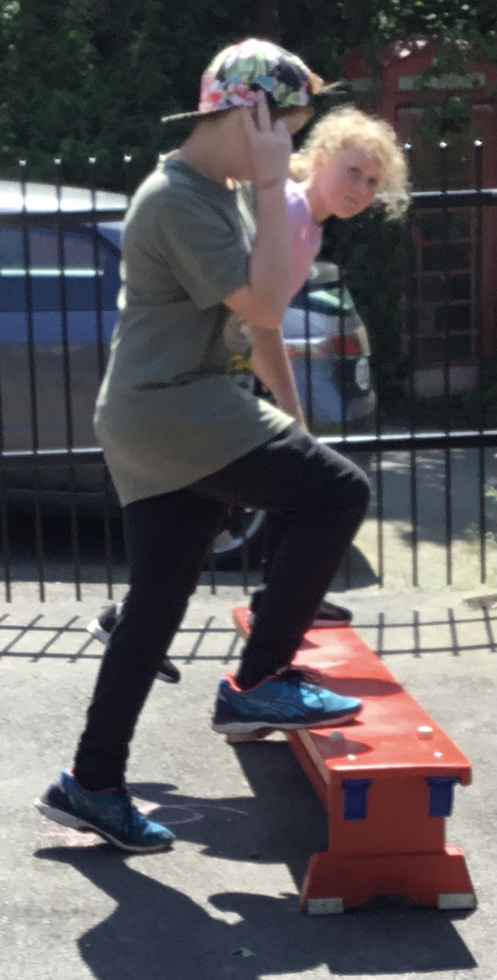
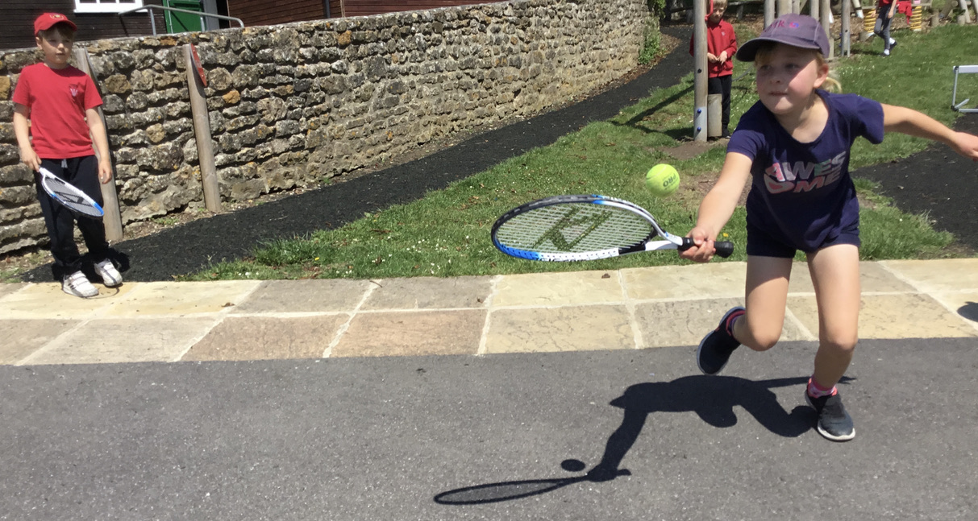
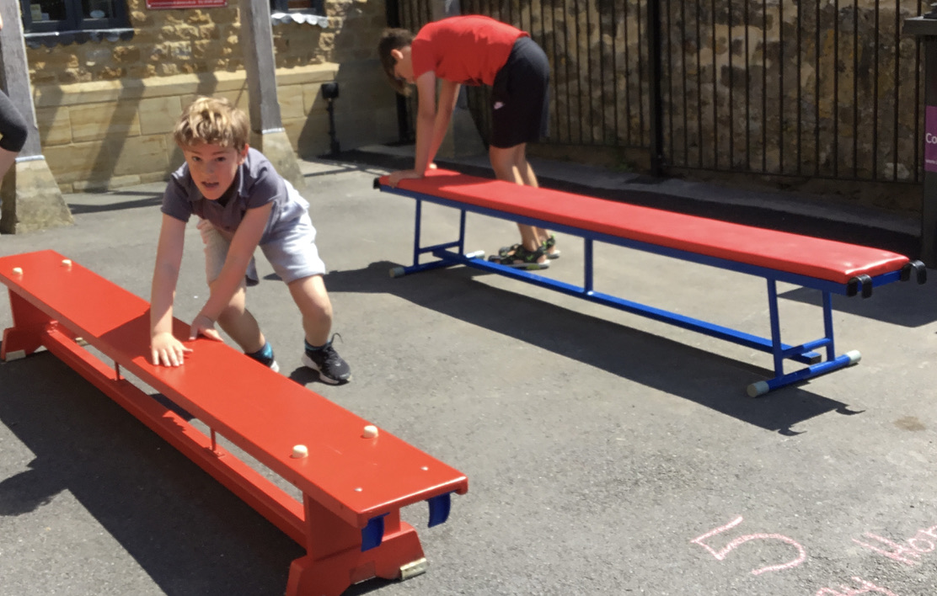
From step ups….
……to bat and ball skills
…..and bunny hops,
we all had a great time.

Slide 17
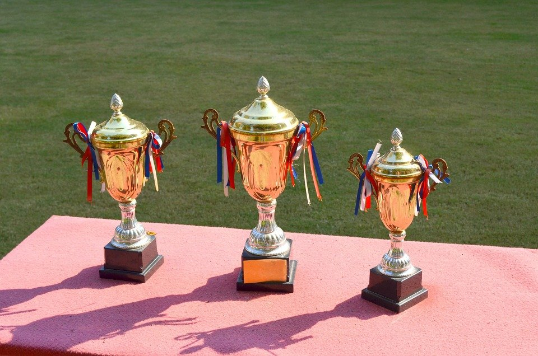
And the winners are……
3rd place: Finley and Ava Mai
2nd place: Harley and Phoebe
1st place: Kitty and Monty
Congratulations!

Slide 18
LKS2 Orienteering and multiskills comments:
The best part about them was….
The ladder and pea game.
Bunny hops.
The sit ups.
Having fun.
Throwing skills.
Working with a new partner.
I like that we were partnered with Seatown.
Almost all of it.
Teamwork.
I have fun!
One thing I have learnt is….
Fun.
I enjoyed it.
Teamwork.
Seatown is good at sport!
If you believe, you can achieve.
I persevered.
I need to improve my sit ups.

Slide 19
UKS2 Orienteering and multiskills comments:
The best part about them was….
Sucking the peas.
Running around and finding the polypockets in orienteering.
Having fun.
Sit ups.
Being able to show all your talents.
That ‘X’ kept me going.
Being with a new person and exploring.
Balancing.
Running around the whole playground and getting excited whenever we see a piece of paper!
One thing I have learnt is….
Getting better.
Playing with people I wouldn’t normally play with.
Trying harder every time.
How to pick a pea with a straw.
How good I am at working with people I wouldn’t usually.
How to do bunny jumping.
I learnt the orienteering signs.
It’s good to work in pairs.
To get more exercise and persevere.
Working together is fun.

